Slide 1
Energy & Water Dashboards

Slide 2
Overview
How utilities are distributed to campus buildings
Metering and data collection
Energy & Water Dashboards – purpose and how to navigate
Continuous improvement of dashboards

Slide 3
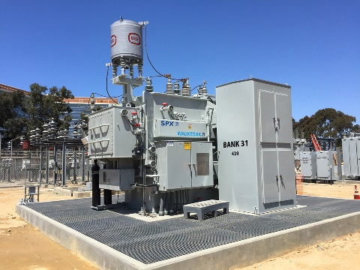
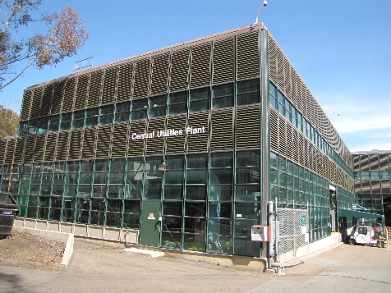
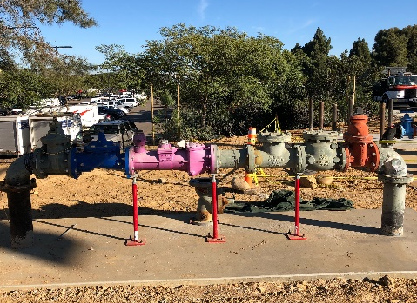
Energy/Utility Infrastructure Overview
Purchased Utilities
Electric
Natural gas
Potable & Reclaimed Water
On-site Generation
Electric
Chilled water, high temp hot water
Electricity
City of SD
UCSD
Natural Gas
Electricity
SDG&E
Potable Water
Reclaimed Water
Chilled Water
High Temp Hot Water
UCSD
Meters
UCSD
Meters
UCSD
Meters
UCSD
Meters
UCSD
Meters
UCSD
Meters
Sub Meter
Sub
Meter
Sub
Meter
Sub
Meter

Slide 4
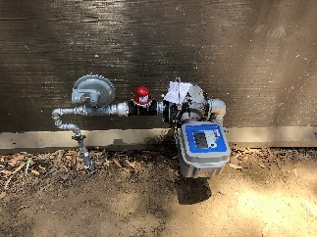
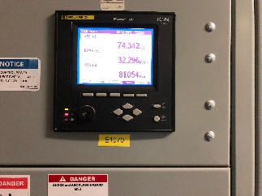
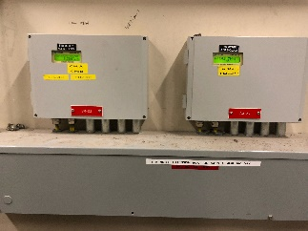
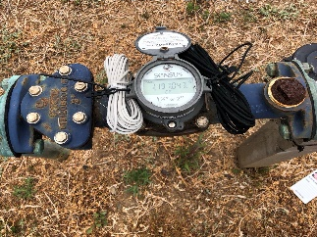
Utility Metering Infrastructure
Over 3,000 meters
Smart (AMR) & non-smart meters
UCSD and 3rd party vendor
Ongoing smart-metering effort
EnergyCAP
Centralized energy/utility database
Interfaced with FM financial
Typical UCSD Gas Meter
Typical UCSD Electric Meter
Typical UCSD Thermal Meter
Typical UCSD Water Meter

Slide 5
Monthly Data Collection Process
Meter readings (FM Utilities)
physical reads (older meters)
auto reads (smart meters)
3rd party bills
Data validation (FM Utilities)
Bill creation and recharge (FM BFS)
Dashboards (FM Utilities)
Compile Meter Readings
Upload to EnergyCAP and Verify
3rd Party Vendor Bills
Bill Creation/Recharge
Cost/Consumption Data Published
25th-8th of the month
8th - 10th of the month
Throughout the month
Last week of the month to first week of next month

Slide 6
Dashboards
Purpose
Easy communication: visual presentation of cost/consumption
User engagement: behavioral changes
Dashboard Grouping:
By major customer groups:
Med center, HDH, SOM, Academic Affairs, Price Centers, Marine Sciences/SIO, Sports Facilities)
By building type
Complex, non-complex, Housing & Dining
By building
Blink Dashboard page

Slide 7
Next Steps
Interval data dashboards (15-min or hourly)
Monthly data available sooner
Need user feedback

