Slide 1
July 2019 Brown Bag Lunch Presentations
Presentation 1: Building Operations Project Team
Presentation 2: Sustainable Buildings & The Climate Action Plan
Presentation 3: Building Services Floor Care Team
Presentation 4: Campus Bin Buddy Program Updates

Slide 2
Over or Under continued….

Slide 3
Building Operations Project Team

Slide 4
AGENDA
What is the project team
Why you would need us
Maximizing your project
Our guarantee

Slide 5
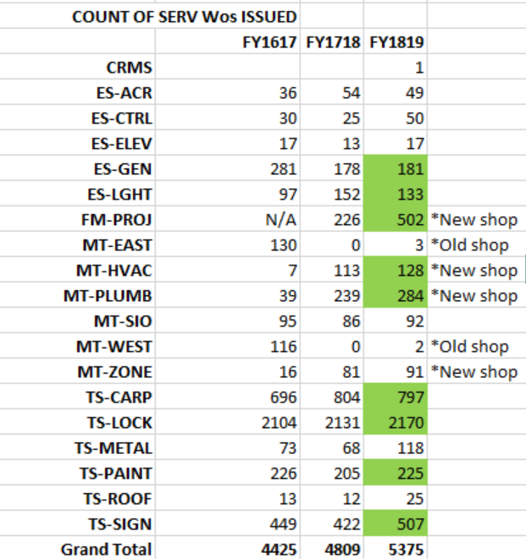
Recharge-Projects

Slide 6
What exactly Is the PROJECT-TEAM?

Slide 7
Customer service
Design
Cost
Manage
Under 50k

Slide 8
Project-team
Multi-trade
One supervisor
Night crew

Slide 9
Design
estimate
schedule

Slide 10
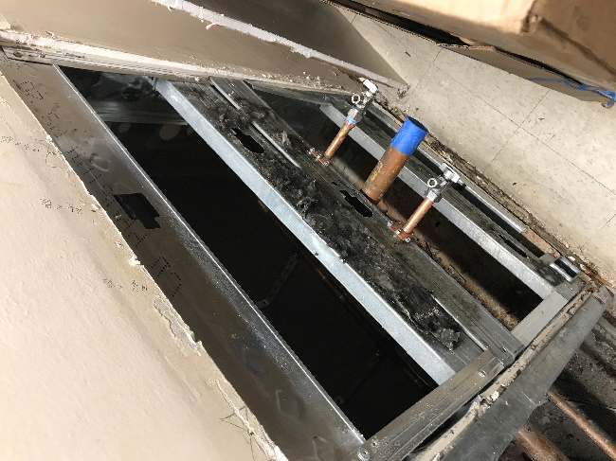
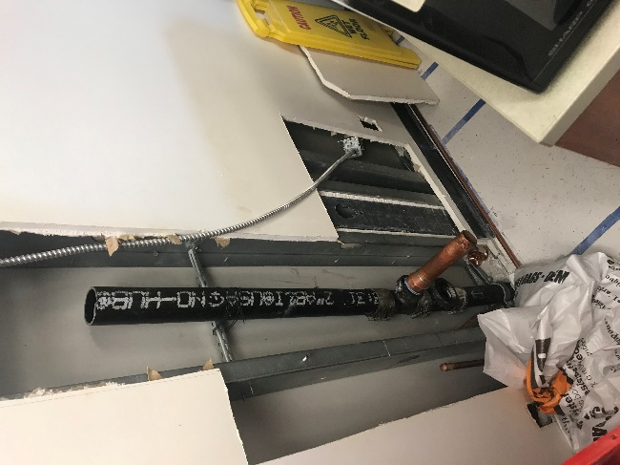
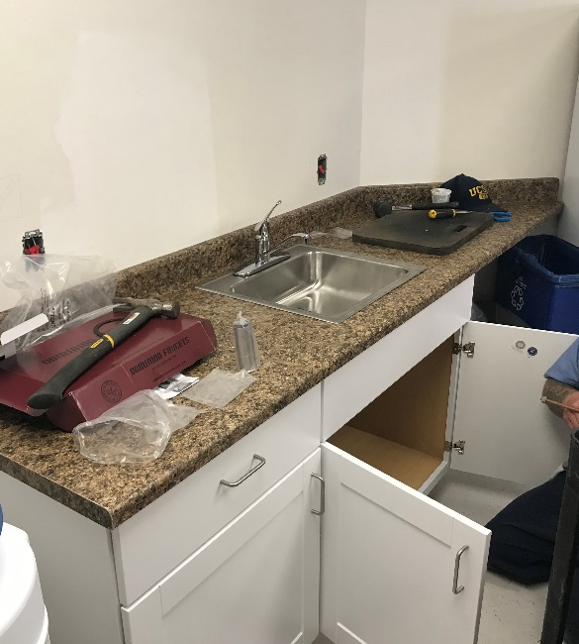
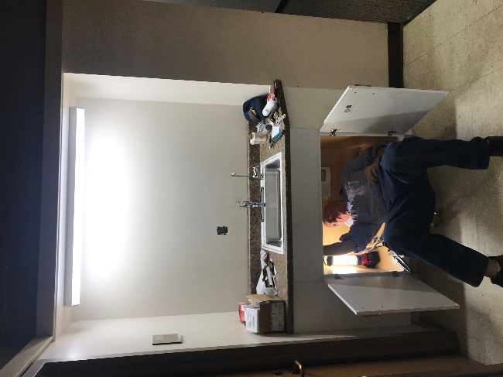
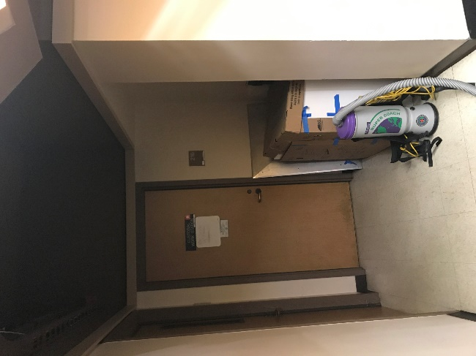
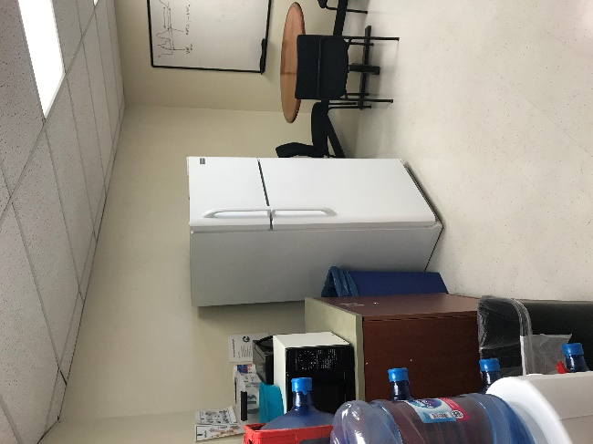
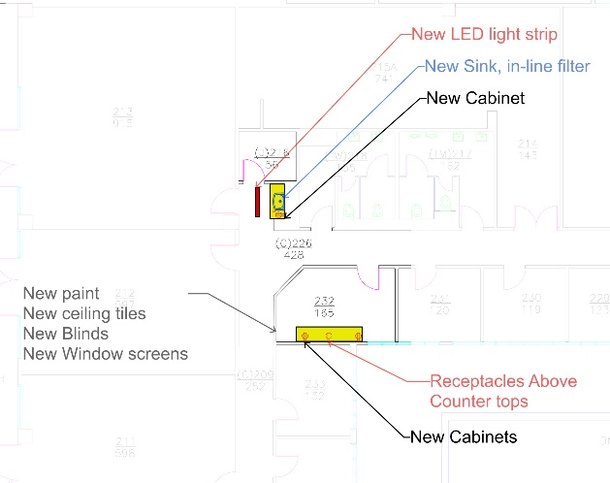
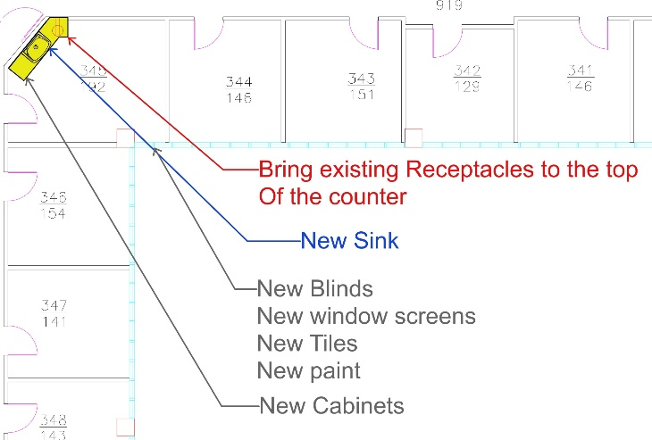
Movement-to-improvement

Slide 11
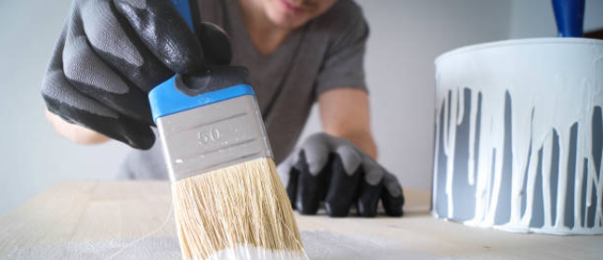
Team members
3 Electricians
3 Plumbers
1 Carpenter
1 Painter
1 AC/R
4 SR BMW’s

Slide 12
Current openings
3 Electricians
1 Painter
1 SR BMW

Slide 13
Speed & Budget
Give detail
Have a plan
Redesign
Pre plan

Slide 14
Our promise to you
Highest quality
Life time maintenance

Slide 15
Use the Project-Team
If you have a project
If you Want to plan a project
Under 50k

Slide 16
Gabriel Almazan
galmazan@ucsd.edu
858-287-2811

Slide 17
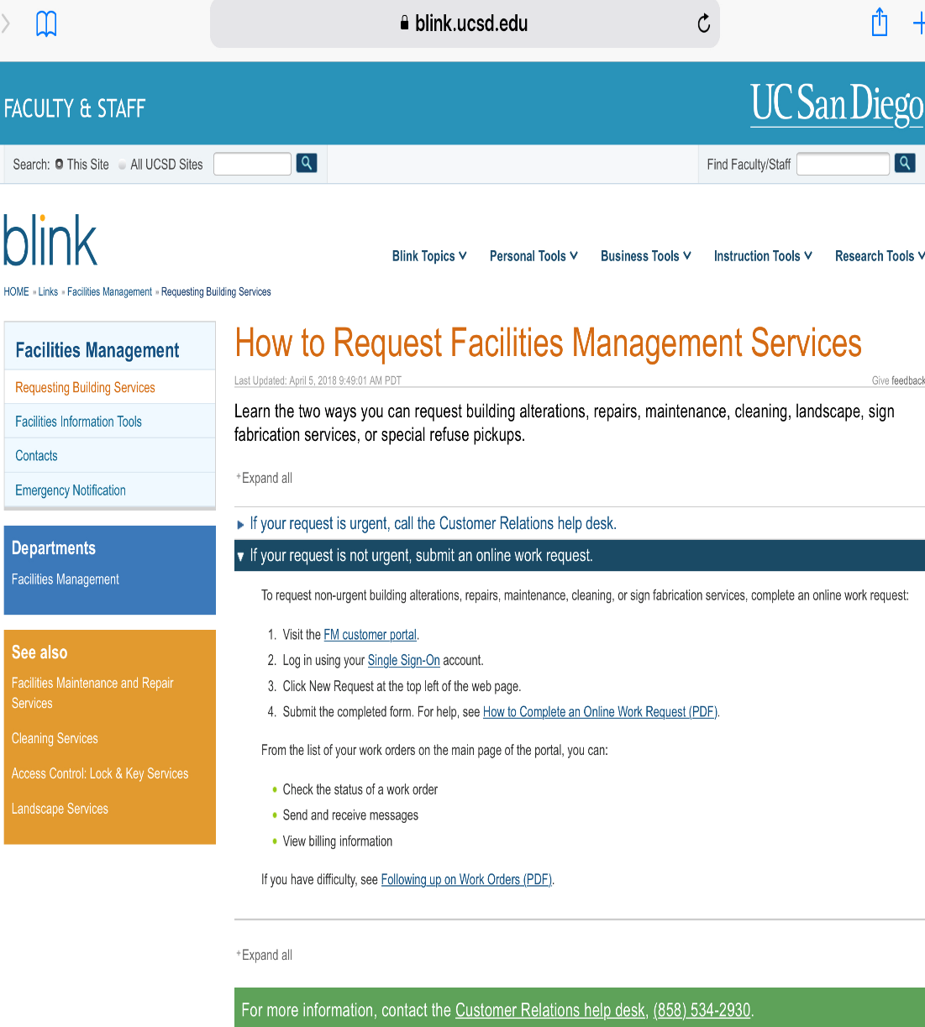
How to submit a Work Order
Work Service Center (858) 534-2930
FM customer portal:
https://blink.ucsd.edu/sponsor/facilities-mgmt/request-services.html#If-your-request-is-not-urgent,-

Slide 18
Sustainable Buildings & The Climate Action Plan

Slide 19
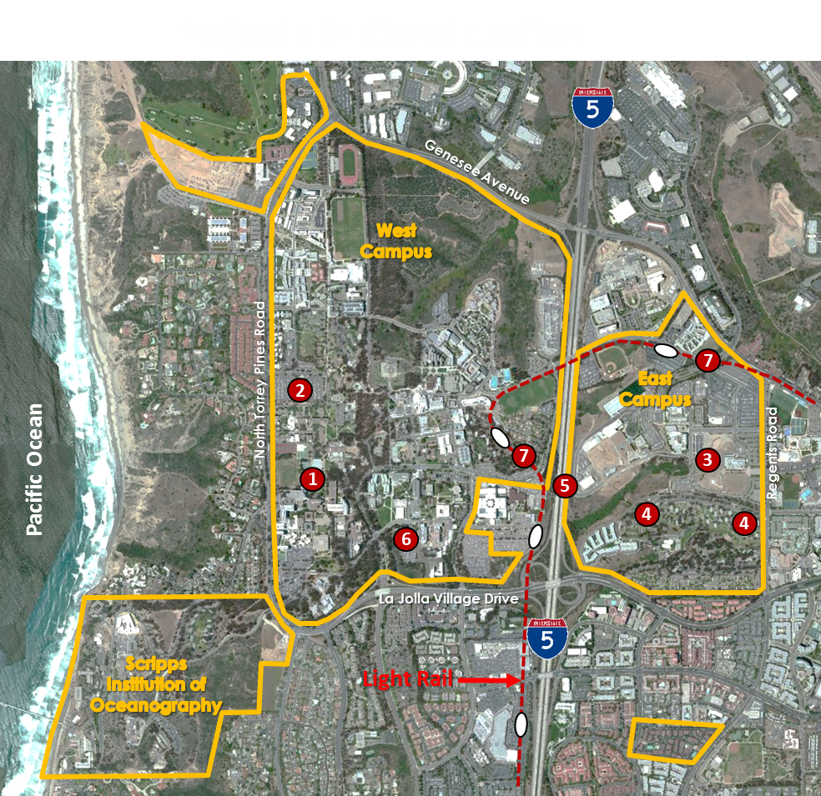
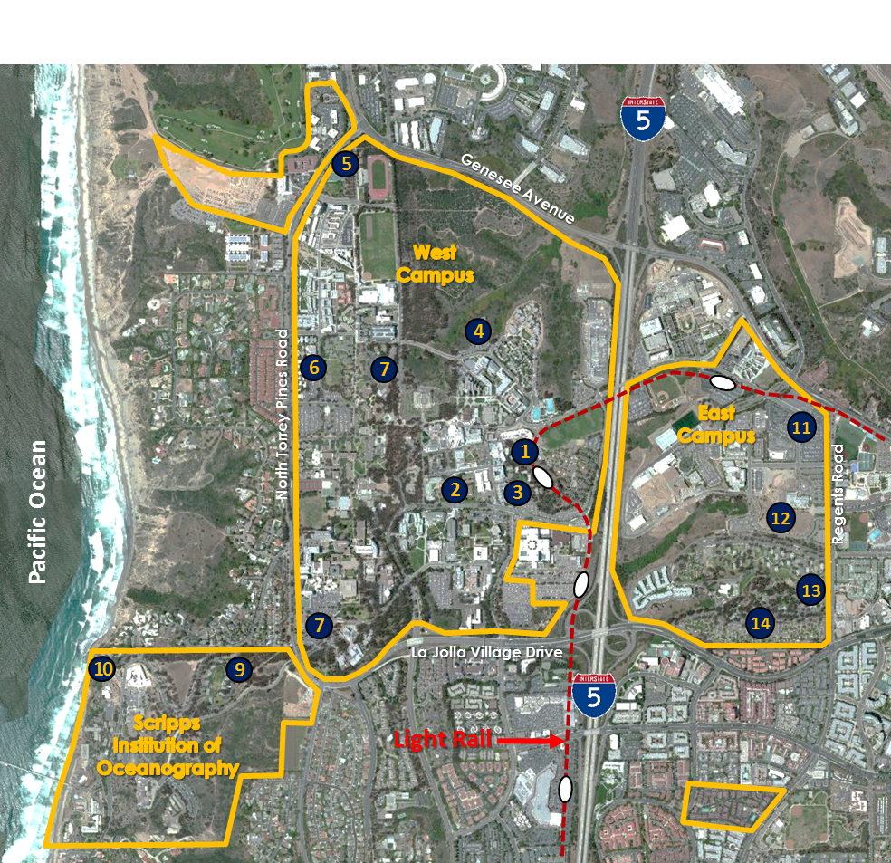
UCSD is Growing!
7 Projects in Construction
Large research enterprise with 2 medical centers, over 900 wet labs
Growing to over 65,000 daily population
Adding over 8.5 million square feet
House 40% of students now, going up to 65%
How do we do all of this sustainably?
14 Projects in Planning
Notes:
We are a large research focused enterprise with 2 medical centers and over 900 wet labs.
We are growing by more than 8.5 million square feet making us one of the fastest growing UC campuses.
So where are we today?

Slide 20
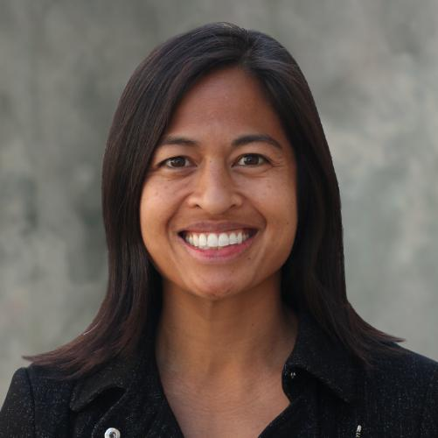
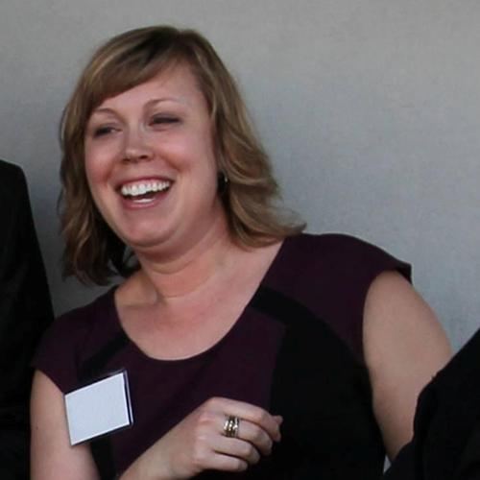
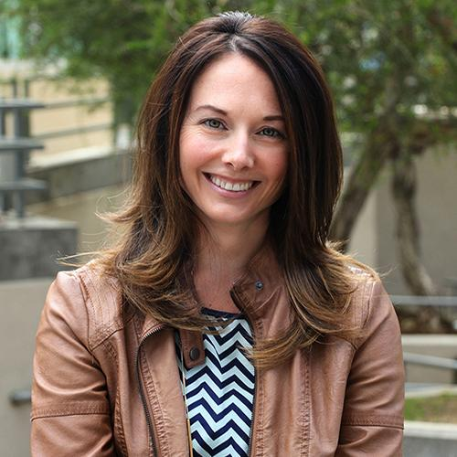
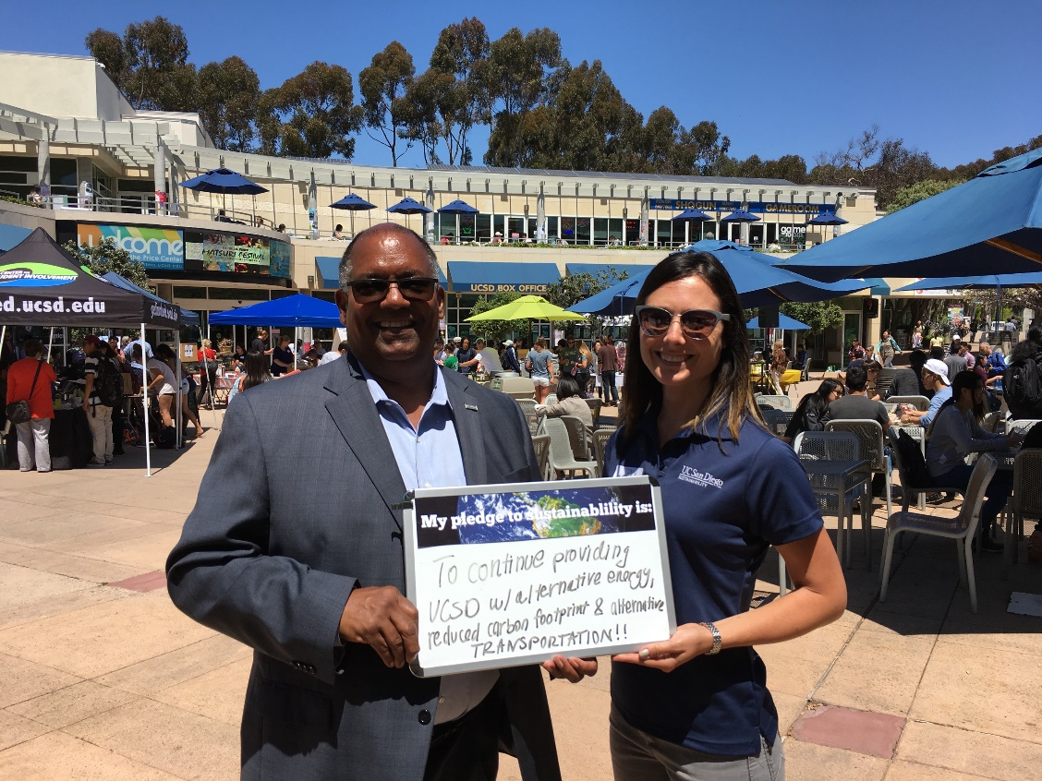
3 staff, student interns and volunteers
Under AVC Resource Management & Planning
Advisory Committee on Sustainability (ACS)
Collaborate across the university
Sustainability staff in other departments
Student organizations (ISC, ESW, USGBC, etc.)
Campus Committees (Open Space, C/CPC, etc.)
Staff organizations (SSN, Green Teams, etc.)
Faculty across campus (CER, USP, etc.)

Slide 21
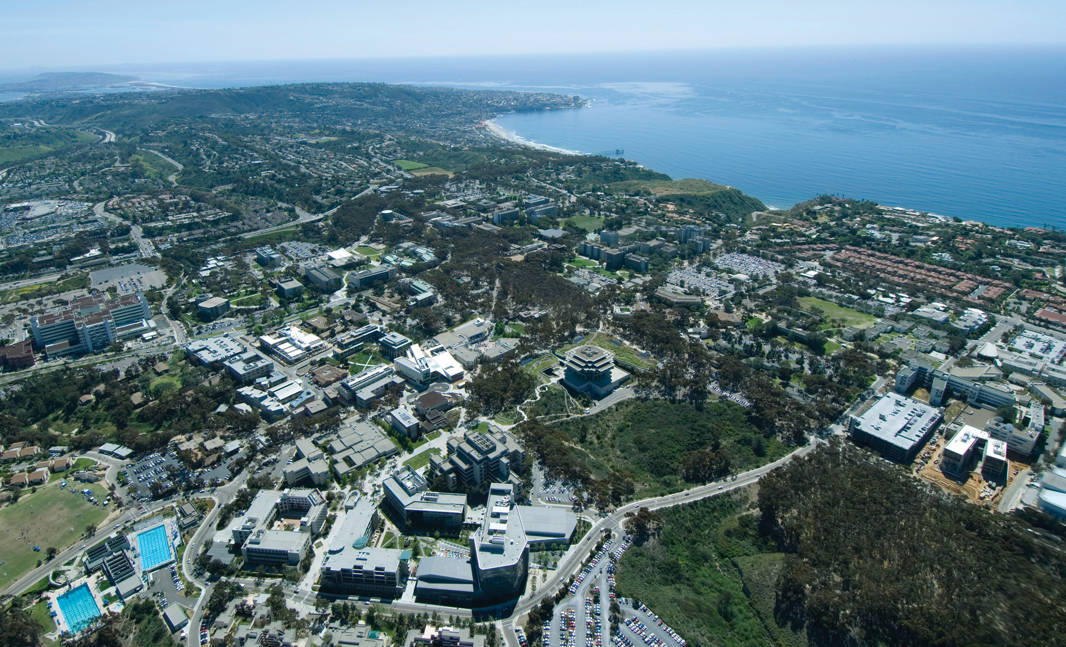
We bring people together across disciplines and departments to infuse sustainability into everything the University does.
Teaching
Research
Engagement
Co-curricular learning
Operations

Slide 22
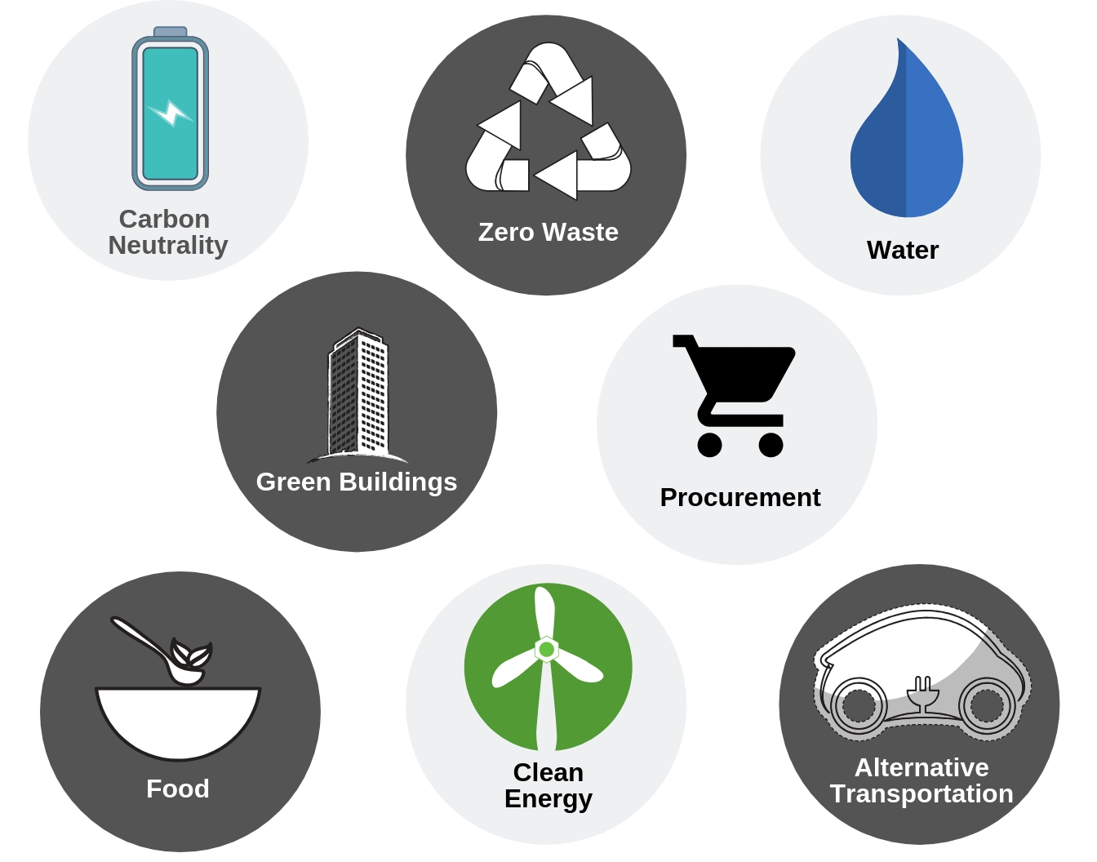
UC
Sustainability
Practices
Policy
Notes:
While we grow, we need to ensure we do so sustainably. Every UC campus has sustainability goals and policies they must meet. You may have heard of some of our goals in carbon neutrality and clean energy, zero waste, water conservation, sustainable food procurement, alternative transportation, and more.

Slide 23
Path to Carbon Neutrality
Ever-evolving
Forward-thinking
Living lab of sustainability
Inclusive of student learning
Financially sustainable
sustain.ucsd.edu/focus/cni.html
Notes:
To help move us towards achieving carbon neutrality, we have developed a plan that includes a comprehensive set of carbon reduction measures including continued energy efficiency, new solar generation and further greening our fleet. Most of the these measures we are already pursuing because they make good financial sense by providing a clear return on investment.

Slide 24
Carbon Neutrality Goals
Scopes 1 and 2 neutrality by 2025
Scopes 1, 2 and 3 neutrality by 2050
Notes:
Announced by President Napolitano in November 2013
The initiative commits UC to emitting net zero greenhouse gases from its buildings and fleet vehicles by 2025.
The Global Climate Leadership Council was formed to advise UC on its ambitious goal.

Slide 25
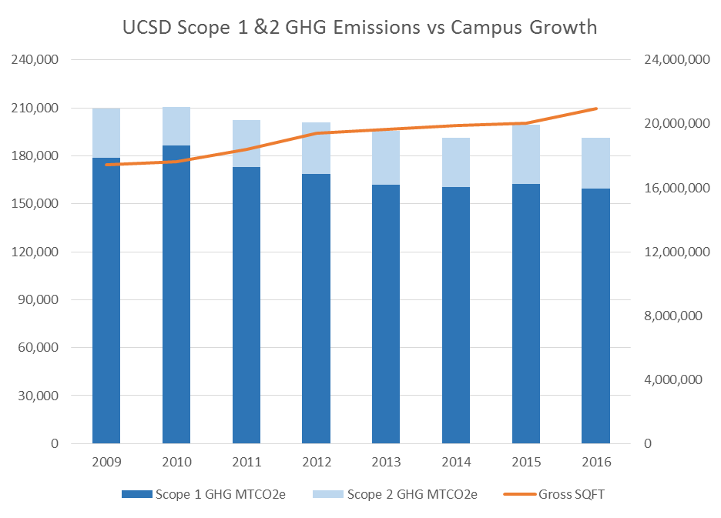
Where we are today
Emissions
Square feet
Notes:
Despite significant growth over the past several years, the campus has been able to reduce its emissions.
We have been able to do this through an aggressive energy efficiency program, adding over 6 MWs of renewable energy, and by building smart, energy efficient buildings.
While we would like to continue this trend, with the upcoming campus growth, limiting emissions will be challenging.
The majority of campus emissions are scope 1, primarily from our cogeneration plant.

Slide 26
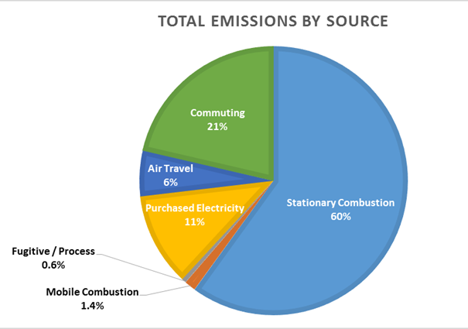
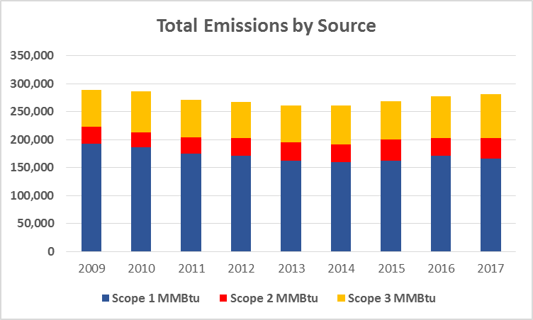
Notes:
Currently we self generate 80% of our energy, with most of that coming from our cogeneration plant.
So the majority of our emissions are from burning natural gas.

Slide 27
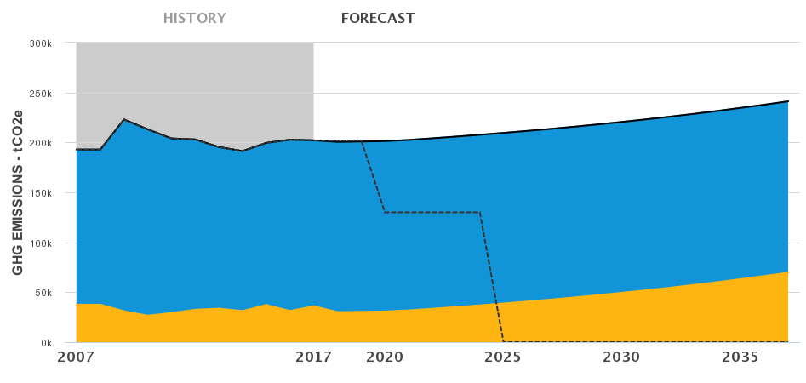
Business as Usual
Total 2017 Emissions: 202,086 MTCO2e
93% of 2017 Scope 1 emissions are from natural gas for cogeneration/other uses and fleet vehicles
Total Emissions Goal
Notes:
The majority of campus emissions are scope 1, primarily from our cogeneration plant.
However, there are other contributors including local boilers and fleet vehicles.
While our total scope 1 & 2 emissions have been decreasing, planned campus growth and increased load will change this.
To help move us towards achieving carbon neutrality, we have developed a plan that includes a comprehensive set of carbon reduction measures including continued energy efficiency, new solar generation and further greening our fleet.

Slide 28
Mitigation Strategies
Existing Building Energy Efficiency Planning
High Performance New Buildings (EUI targets)
Renewable Energy (Onsite and UC ESU)
Campus Fleet
Commute Options
Air Travel
Space Utilization
Behavior and Institutional Change
Carbon Offsets
Scenario Analysis and Recommendations (Cogen)
Notes:
All grid power 100% carbon neutral (2021); 40% directed biogas (2025)

Slide 29
Cogen scenarios
Resiliency
Redundancy
Reliability
Safety
Affordability
Around 2032, mix of options:
Directed biogas: 10-40%
Electrification (UC ESU)
New technologies

Slide 30
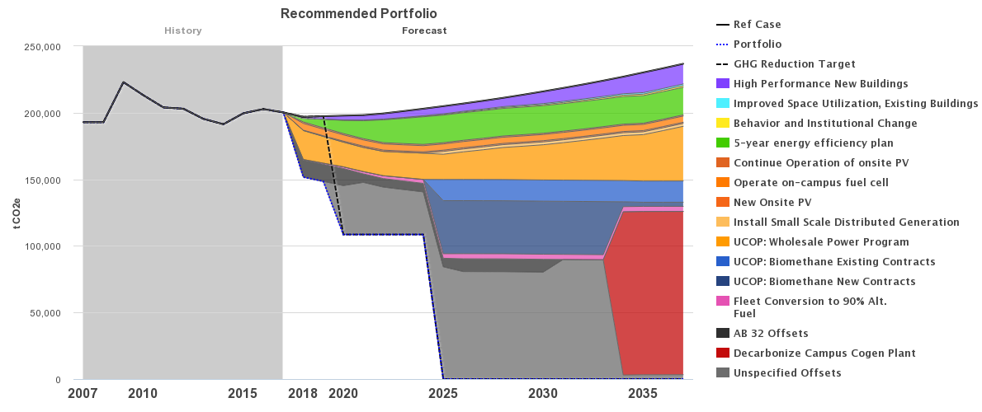
Notes:
We believe that we have a plan that provides reasonable near and long term measures that can get us to carbon neutrality.
Any decisions that are made will be based on fiscal realities as well as maintaining energy reliability, resiliency and security.
All options for achieving carbon neutrality come at a cost, so the challenge is finding the mix that makes the most financial sense.

Slide 31
Sustainable
Building
Policy
Sustainable Buildings Policy that includes environmental and human health and wellness
Sustainable Buildings Guidelines with training for key staff
Sustainability incorporation into contracts and leases
Metrics to measure progress
Guidance to help pick the right design and build teams
Student learning opportunities

Slide 32
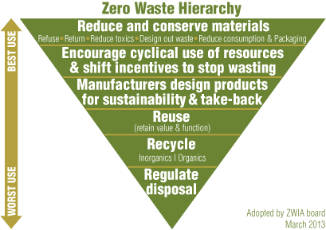

Slide 33
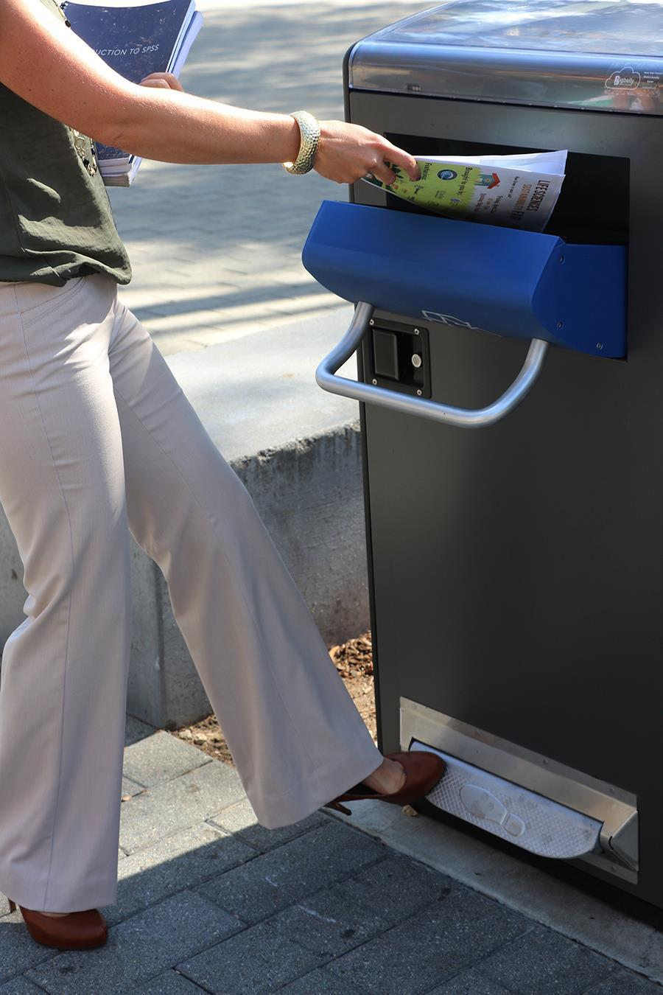
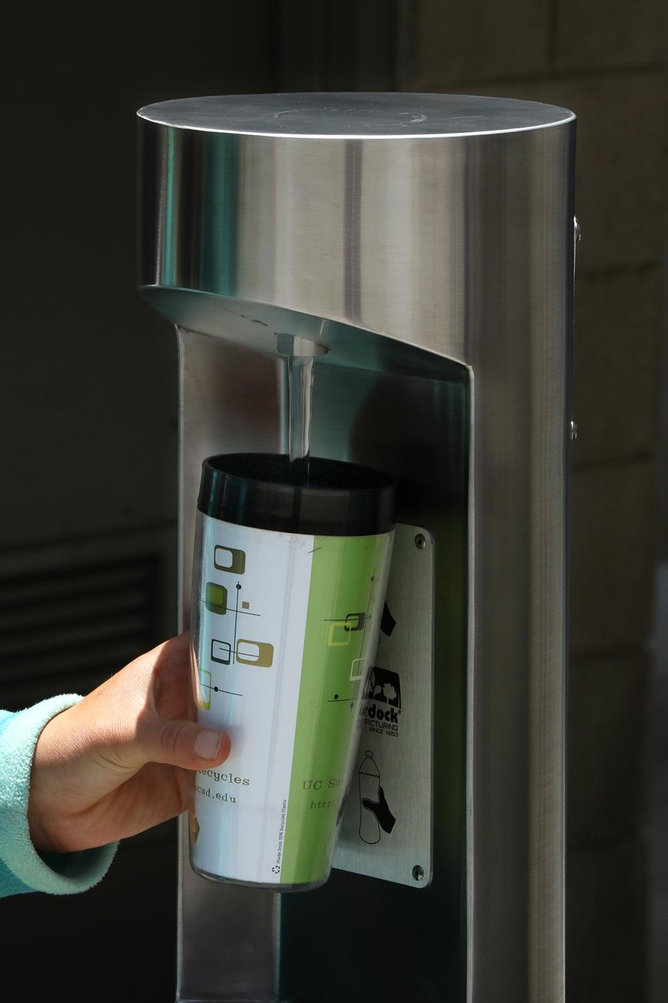
Zero Waste Goals
Reduction
Reduce waste generation per capita to:
FY2015/16 levels by 2020
25% per capita from FY2015/16 levels by 2025
50% per capita from FY2015/16 levels by 2030
Diversion
90% diversion of municipal solid waste from landfill
Foam Ban
By 2018, no foam shall be used in food service facilities for takeaway containers.
By 2020, prohibit the sale, procurement or distribution of foam other than that utilized for laboratory supply or medical packaging and products.
Notes:
Announced by President Napolitano in November 2013
The initiative commits UC to emitting net zero greenhouse gases from its buildings and fleet vehicles by 2025.
The Global Climate Leadership Council was formed to advise UC on its ambitious goal.

Slide 34
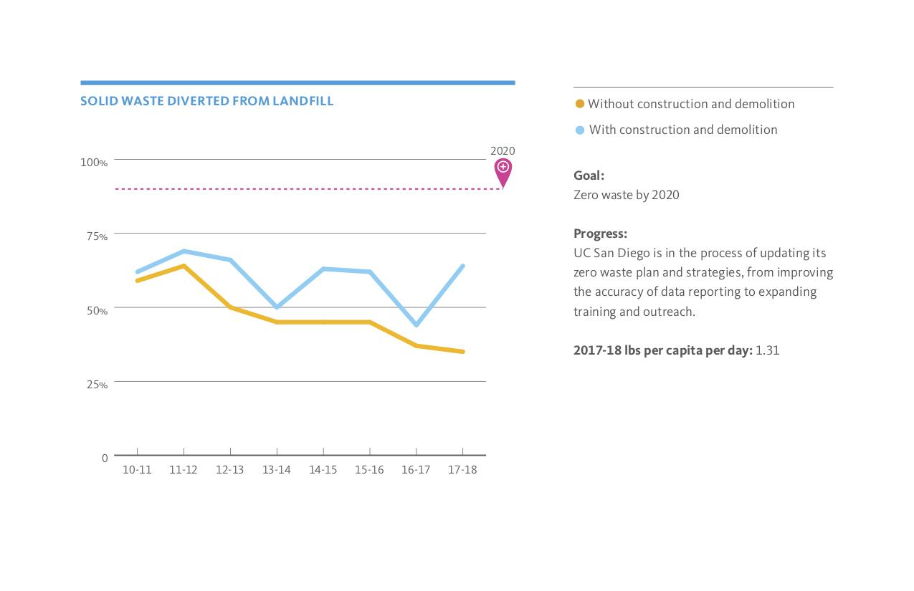

Slide 35
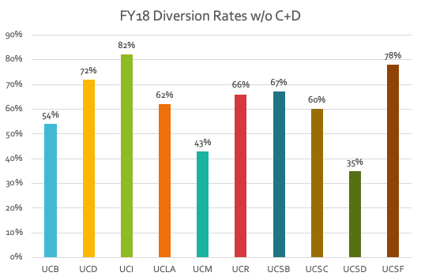

Slide 36
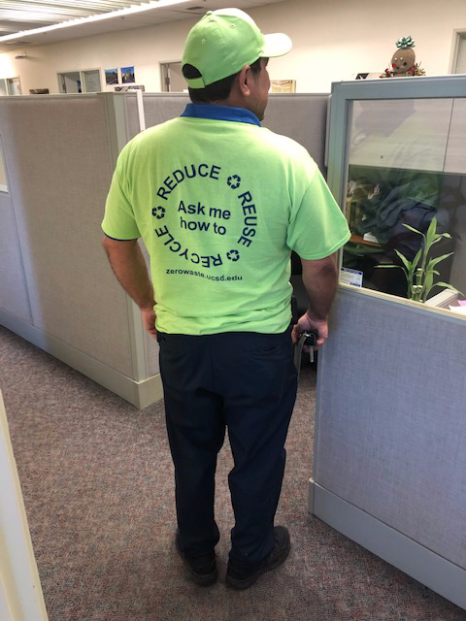
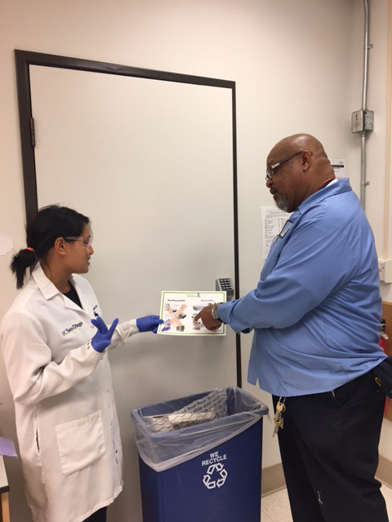
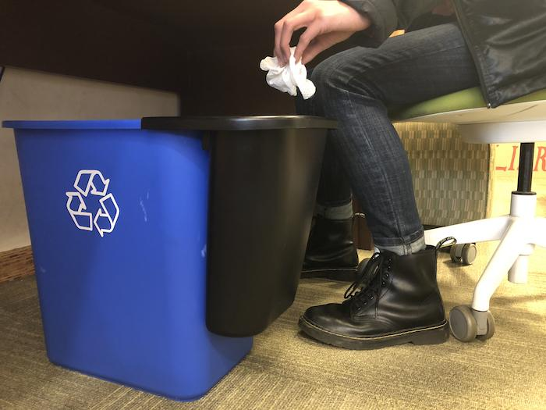
Zero Waste
University-wide working group and plan
Reduction and reuse
New hauler
Standardized colors and signage
Training, education and outreach
New: green event standards, composting, etc.

Slide 37
….but we need YOUR help to meet our goals!
Carpool, bike, walk and take transit
Drive an electric vehicle
Follow @SustainUCSD on social media
Give up meat once/week
Green your office and lab
Go digital and print smart
Host a green event
Recycle
Report water leaks
Sign up for the Sustainability newsletter
Turn off and unplug
Use reusables (mugs, water bottles, utensils, etc.)
Use Surplus Sales
Visit the Sustainability Resource Center

Slide 38
STAFF
SUSTAINABILITY
NETWORK

Slide 39
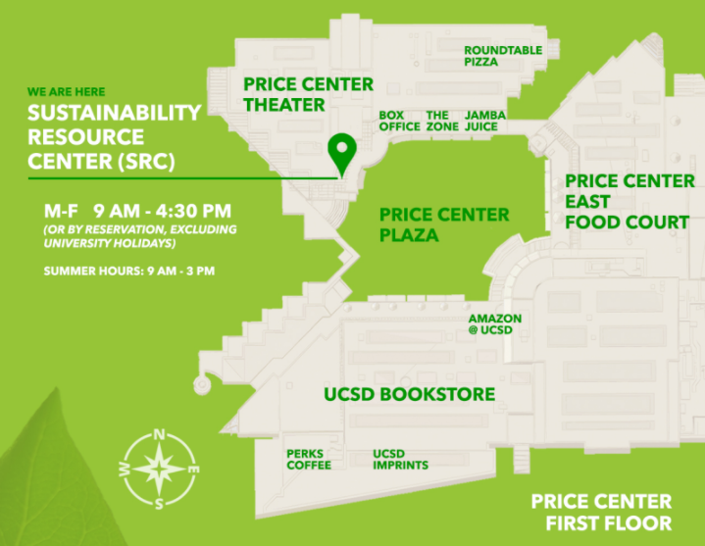

Slide 40
sustain.ucsd.edu
sustain@ucsd.edu

Slide 41
Building Services Floor Care Team

Slide 42
About the Floor Care Team
The group consists of 7 members and a Supervisor.
Sunday-Wednesday 6:00pm to 4:30am
Group dedicated exclusively for floor and carpet care

Slide 43
Types of floor we currently service
(VCT) Vinyl Composition Tile
Concrete
Ceramic
Linoleum
Terrazzo
Rubber/Cork

Slide 44
Rubber/Cork
Before
AFTER

Slide 45
VCT
Before
After

Slide 46
Types of carpet we currently service
We service most carpets, Including carpet tiles and stain resistant carpets using:
Hot extraction
Extraction
Dry foam
Bonnet

Slide 47
How to Request Service?
Submit a work order online
Contact custodial supervisor responsible for the building
Contact floor care supervisor

Slide 48
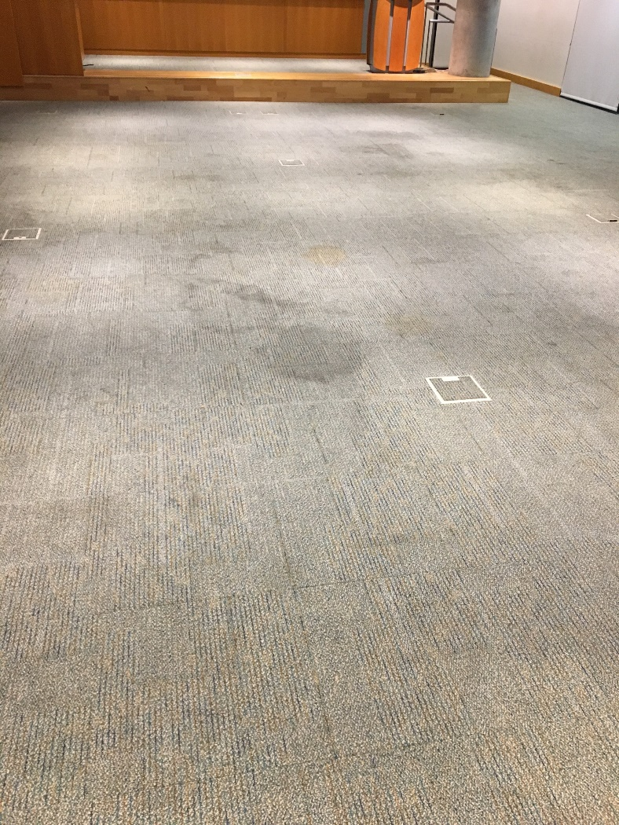
EBU2A Carpet Cleaning

Slide 49
How to prepare for the day of the service?
Remove all moveable items from the area such as:
Chairs
Boxes
Trashcans
Furniture
Equipment

Slide 50
Questions??

Slide 51
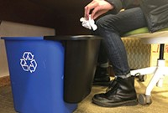
Campus Bin Buddies Program Update

Slide 52
Campus Bin Buddies Program Update
Offices & cubicle space areas
No liners in bins
Service frequencies remain the same
Install slim jims

Slide 53
Campus Bin Buddies Program Update Implemented Colleges
SIO
Revelle
Muir
Marshall
Geisel Library
Warren
CSC
University Center

Slide 54
Campus Bin Buddies Program Update In progress
School of Med
ACTRI

Slide 55
Campus Bin Buddies Program Update Lessons Learned
Communication
Slim jims timing install
Accessibility breakroom sinks

Slide 56
Campus Bin Buddies Program Update
Completion August 2019
Near Future

Slide 57
Campus Bin Buddies Program Update
Q & A

