Slide 1

June 2019 Brown Bag
Lunch Presentations
Facilities Management Summer Projects

Slide 2

FM Building Services Summer Projects & Deep Cleaning
June 25, 2019
Jason Kayne, Interim Director of Facilities Management

Slide 3


Slide 4
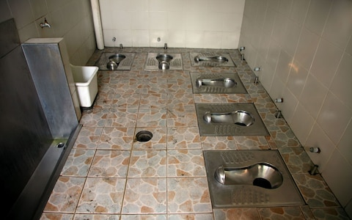
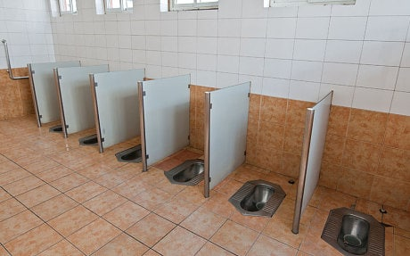
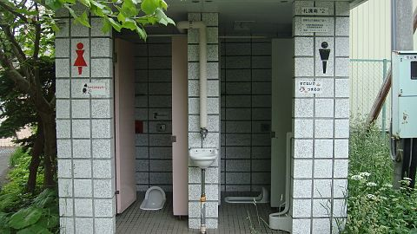

Slide 5
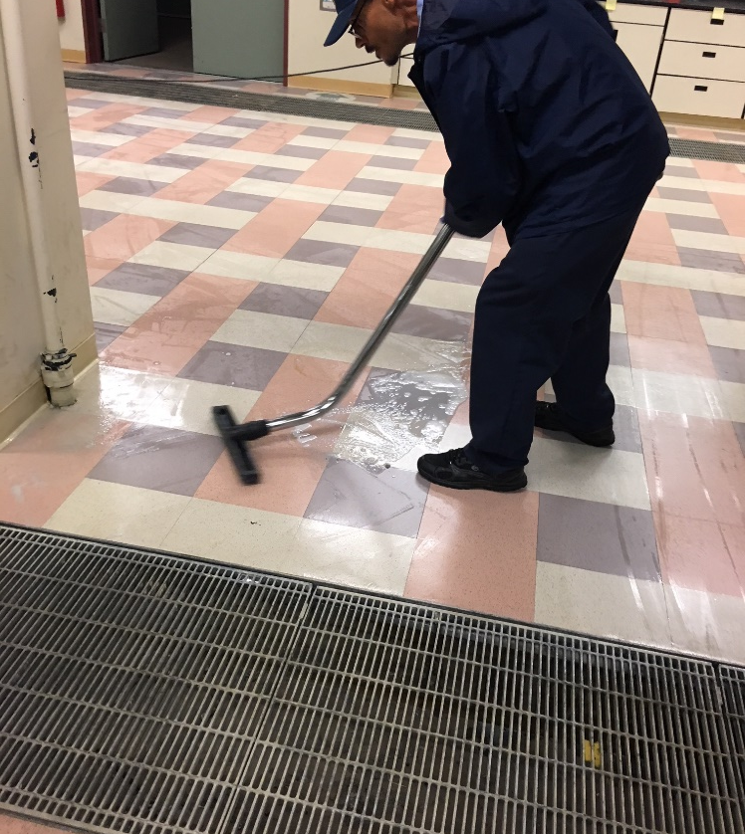
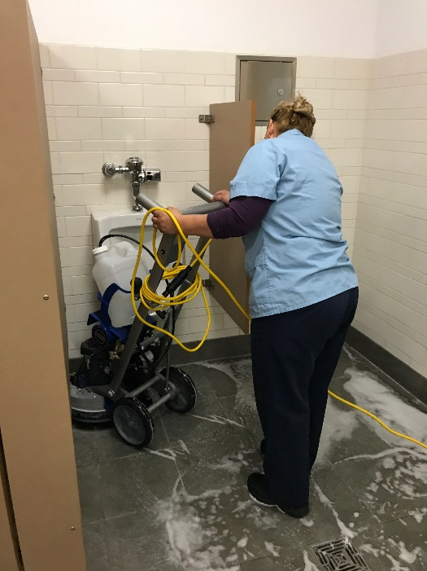
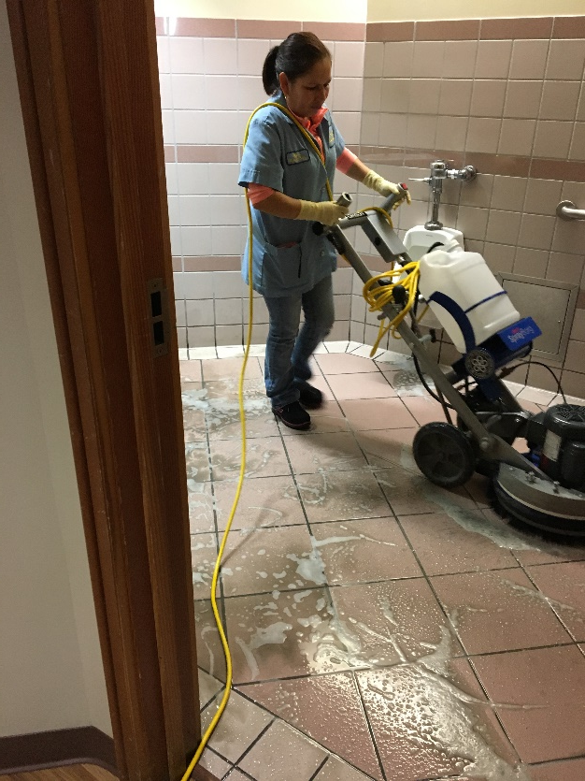
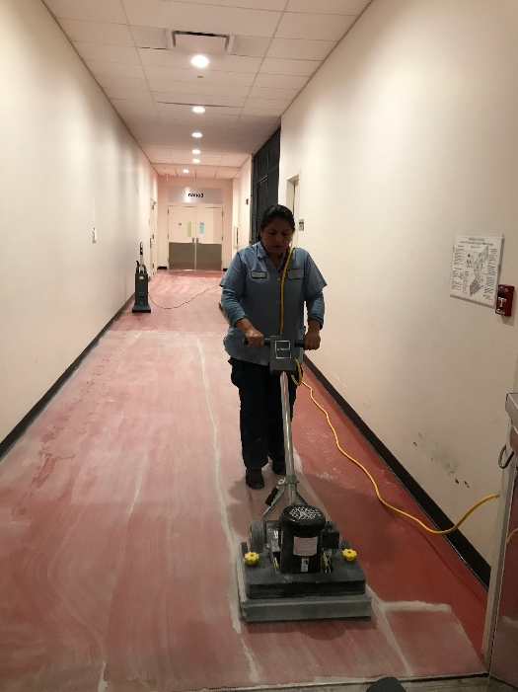
UC San Diego Summer 2019 Building Services Projects
What it is – Deep Cleaning (closer attention to details: partitions, fixtures, window sills, walls, doors and frames, podiums, kitchennettes, conference room furniture, etc) & various Floor Care Projects (strip & wax, restroom grout scrubbing and sealing, carpet care, concrete polishing, etc) of FM maintained spaces.
Deep clean restrooms, conference rooms, public areas, kitchenettes, break rooms, libraries, recreation facilities and classrooms
Deep cleaning may include:
  Removing hard water deposits, graffiti, dust, heavy dirt, grease marks & chalk buildup in classrooms, among others
  Detail vacuuming, damp mopping, high & low dusting
  Vacuum stairwells and clean handrails

Slide 6
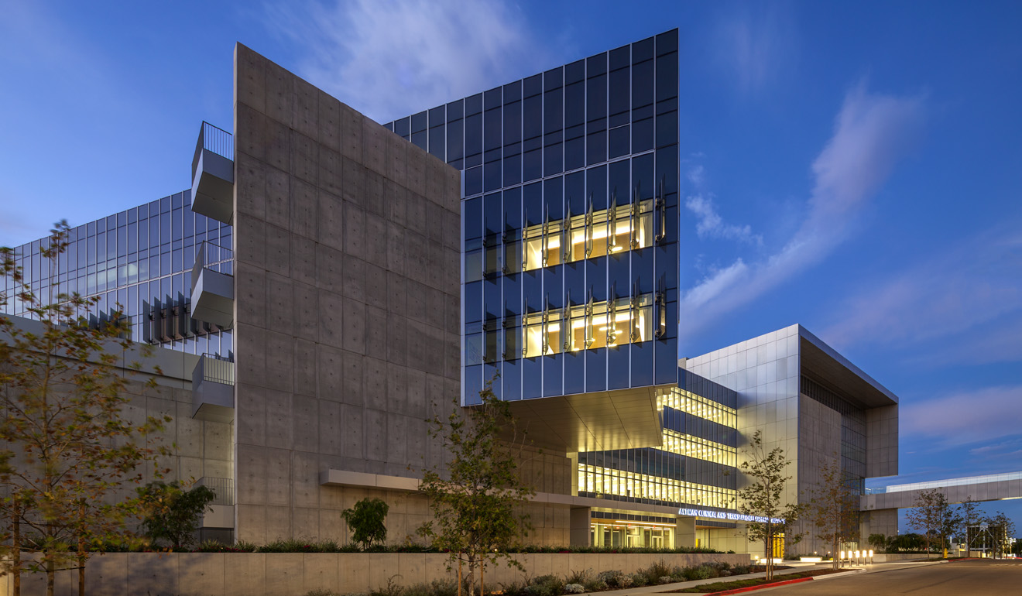
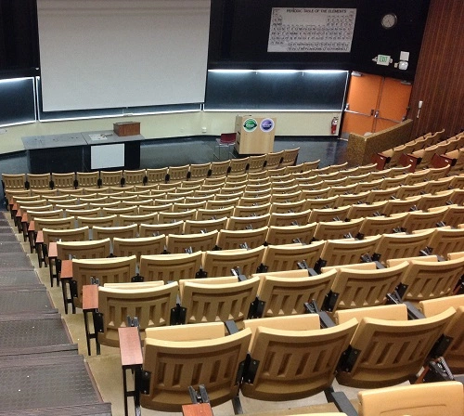
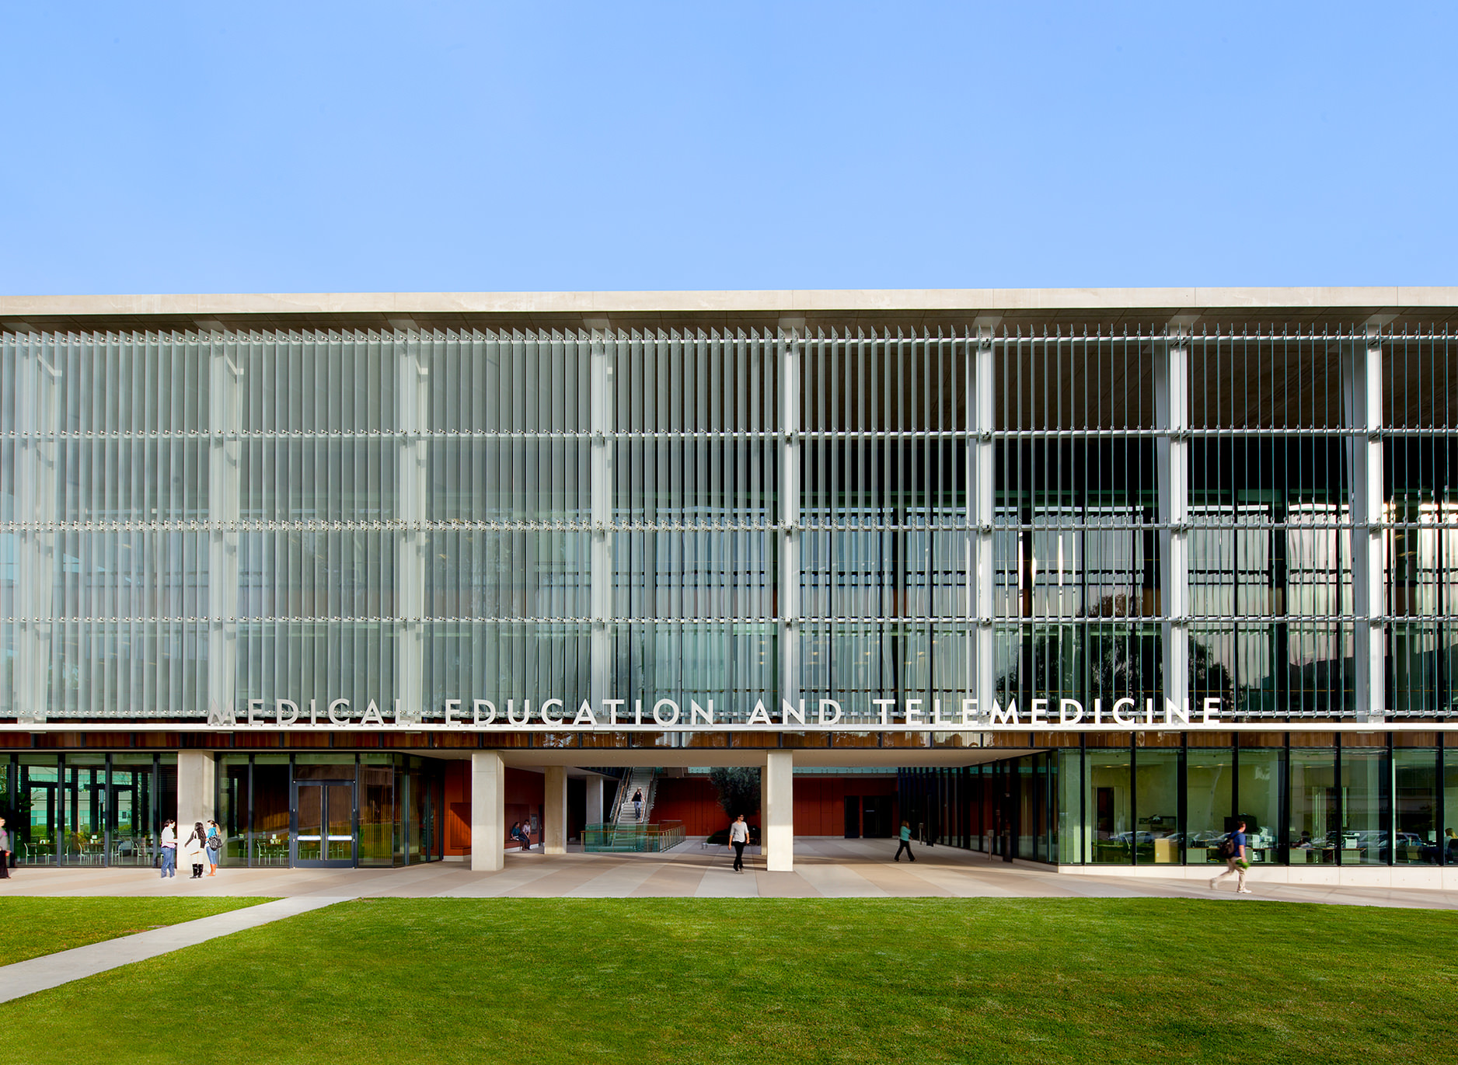
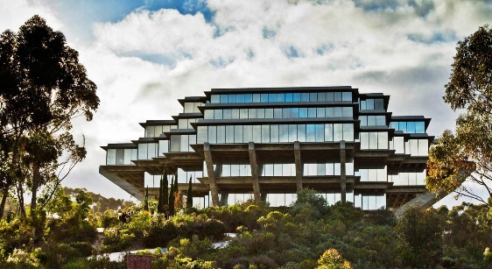
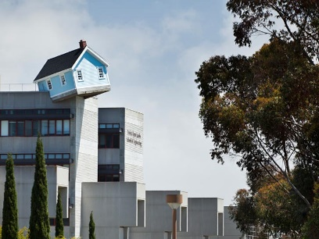
Buildings Included in this summer’s Projects
ACTRI
AP&M
Asante
Atkinson Hall
BioMed Library
BSB
Bonner Hall
BRFII
CSC
Center Hall
CMMW & CMME
Cog Sci
CRF
CUP Telecom
EBU I, II, IIIA & IIIB
Economics Building
ECEC & MCDC
Eckart
ERC
Galbraith Hall
Geisel Library
Gildred
Guava
H&SS
Holly
Hubbs Hall
IRPS
Ivy
IMG’s 1 – 4
IOA
Jacaranda
Kalmia
Keck 1 - 3
Laurel
Leichtag
Literature Bldg
LGBT Bldg
Magnolia
Main/Recreation Gym
Mandeville
Mayer Hall
Mandler
McGill
Media Center
Mesom
MTF
Muir Biology
Natatorium
NSB
Nierenburg Hall
Old Scripps Admin Bldg
Osler Parking Structure
Otterson Hall
Pacific Hall
Pepper Canyon Hall
Peterson Hall
Prebys Music Bldg
Scholander
SDSC addition
Sequoyah Hall
Skaggs Pharmacy
SME
Solis Hall
Spanos
Stein
SSB
SSC
SSRB
Telemedicine
TPCN
Urey Hall
Vaughn Hall
Visual Arts
Warren Lecture Hall
York Hall
201, 400, 409
Many others…

Slide 7
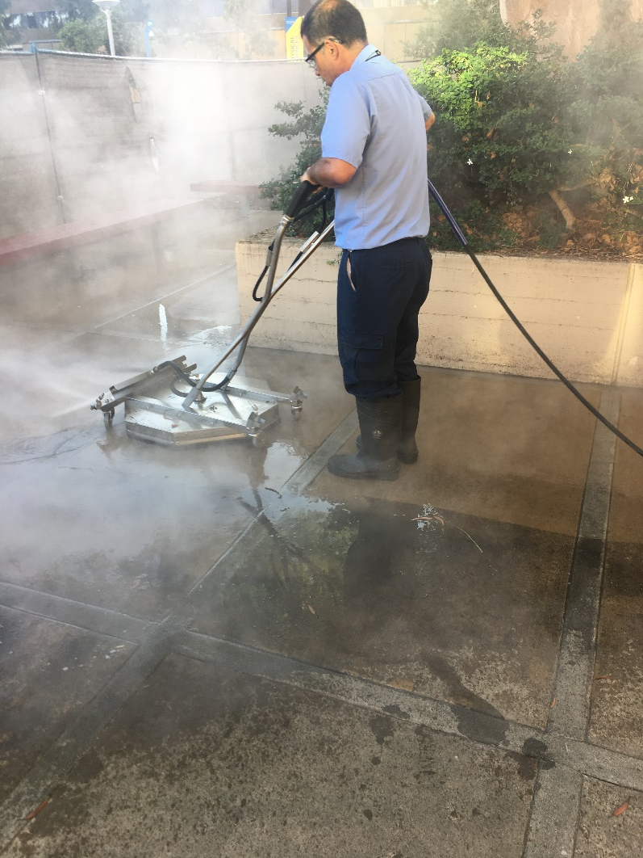
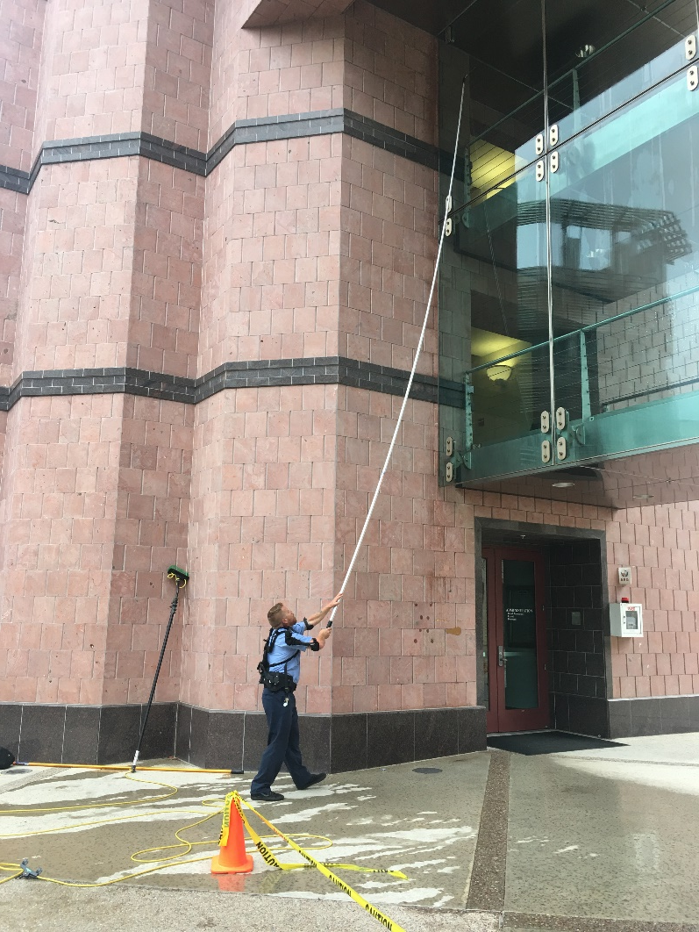
Additional Deep Clean Projects
Porter Service deep cleaning of high volume restrooms
Detailing of our Fleet Vehicles
In-House & contracted window washing
Power washing sidewalks & walkways
Blind cleaning & repairs
We can schedule other areas/buildings as needed

Slide 8
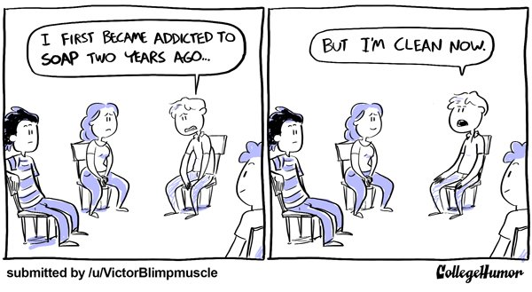
Deep cleaning examples

Slide 9
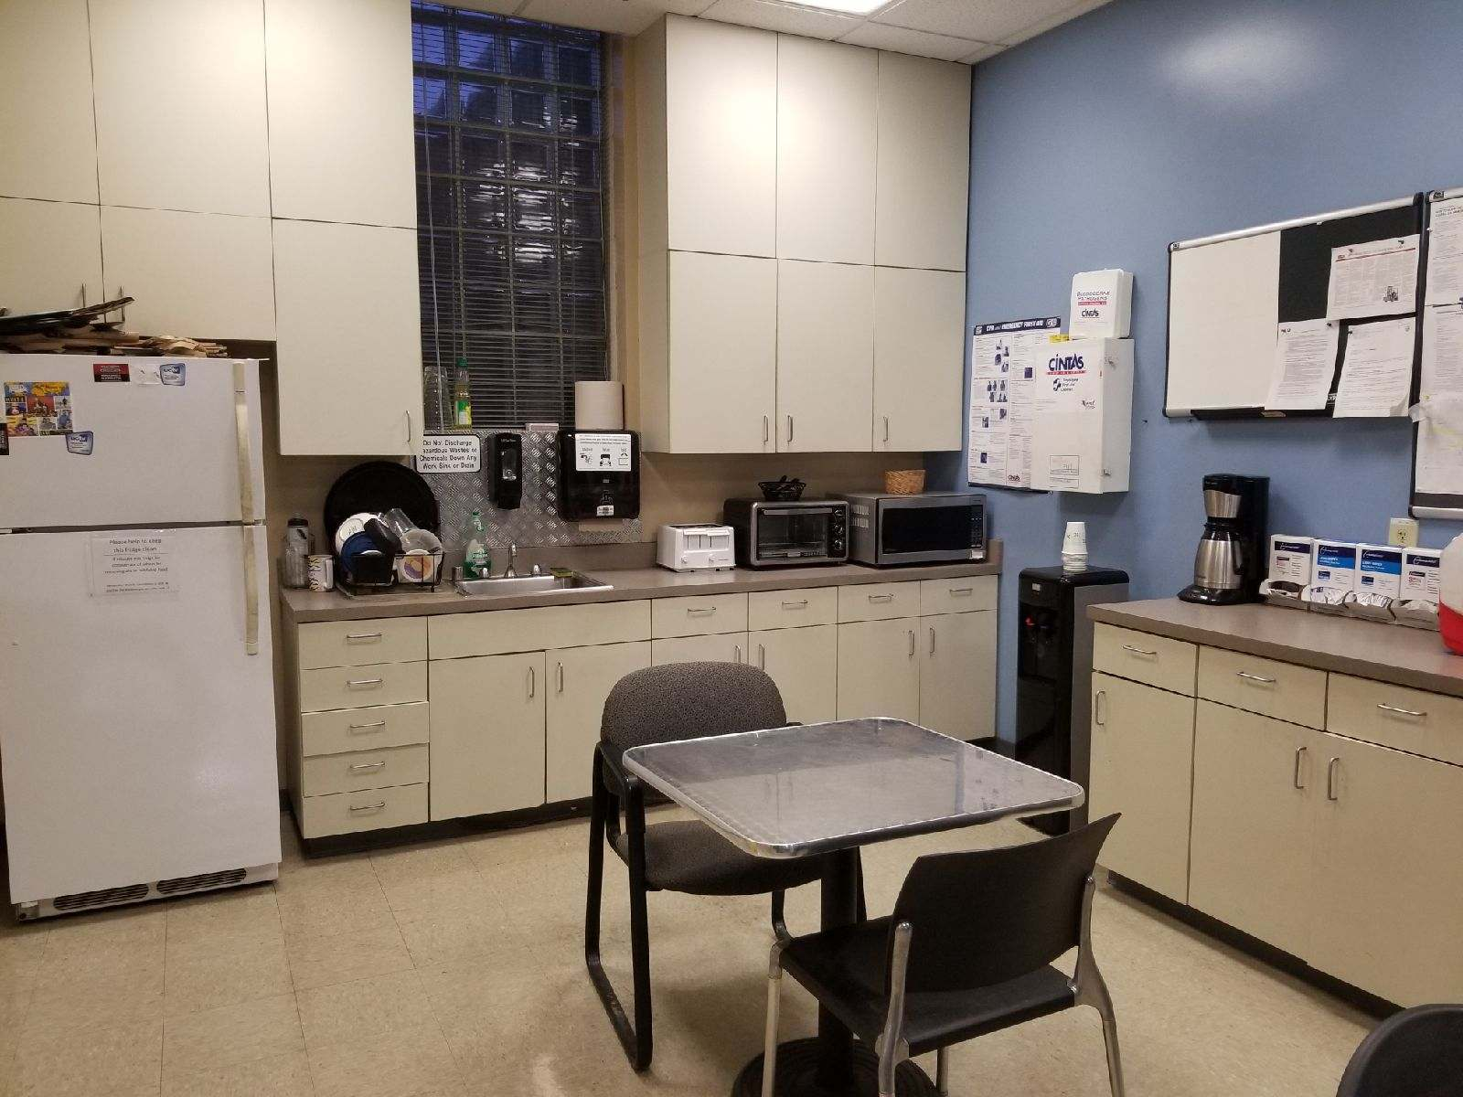
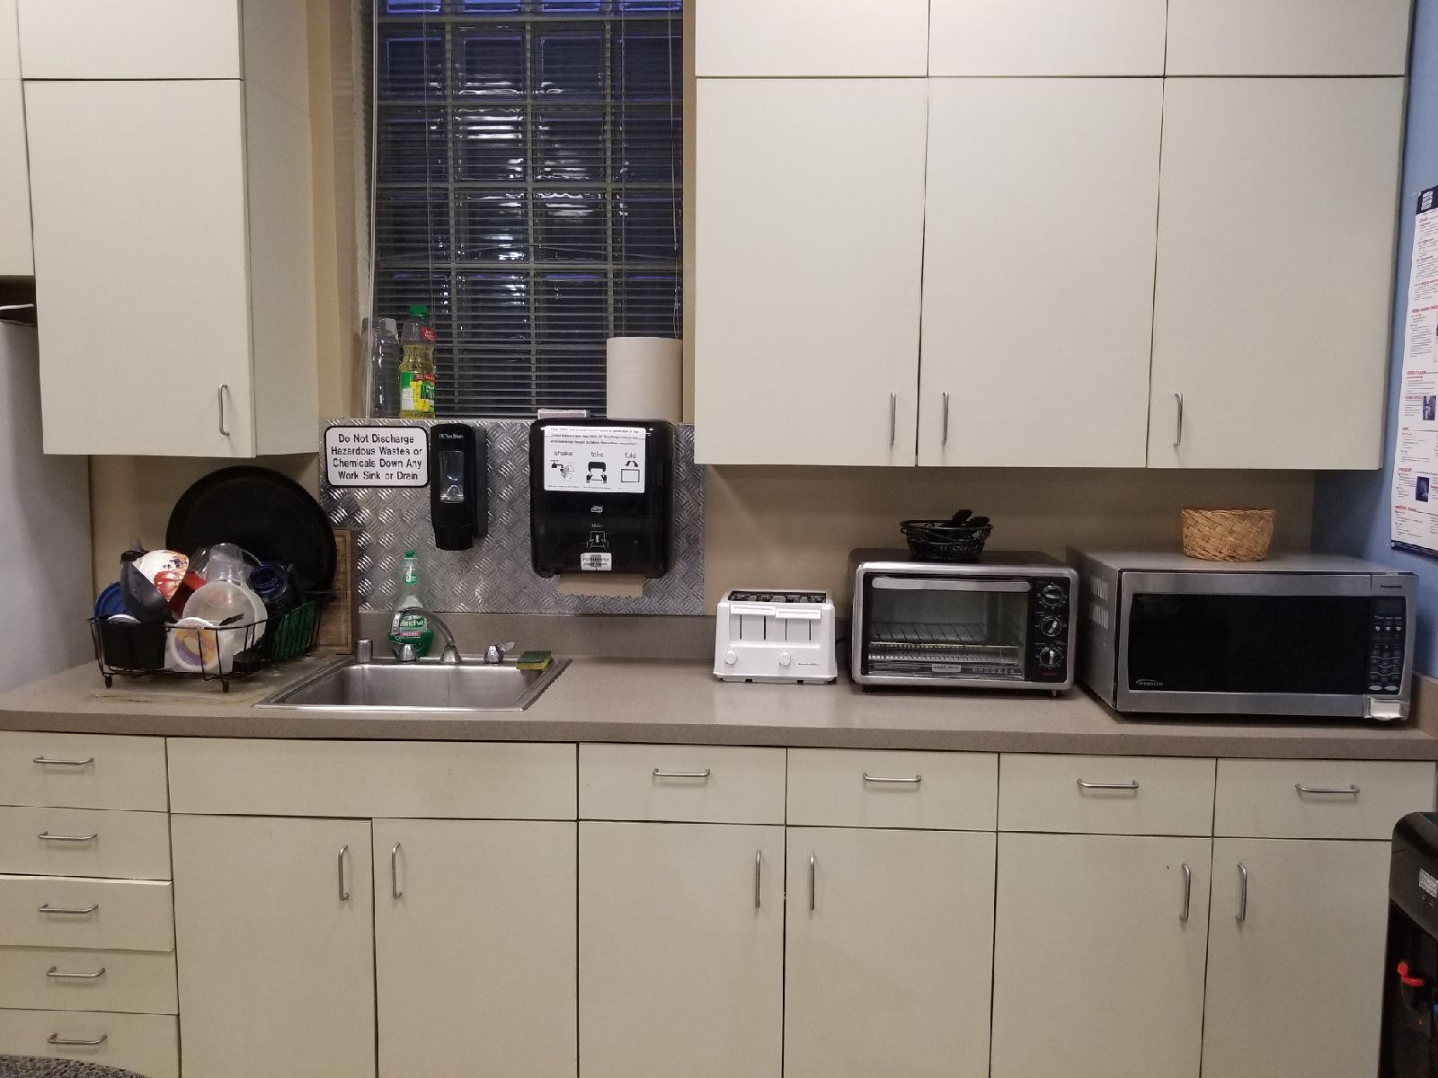
Kitchenettes & Break rooms

Slide 10
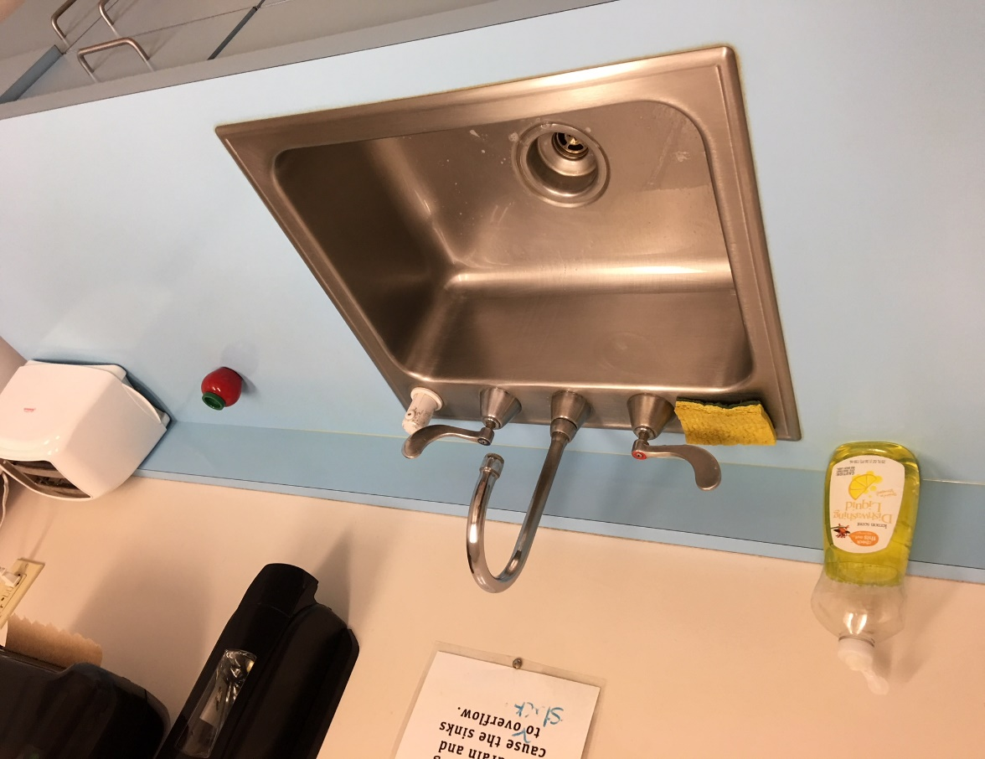
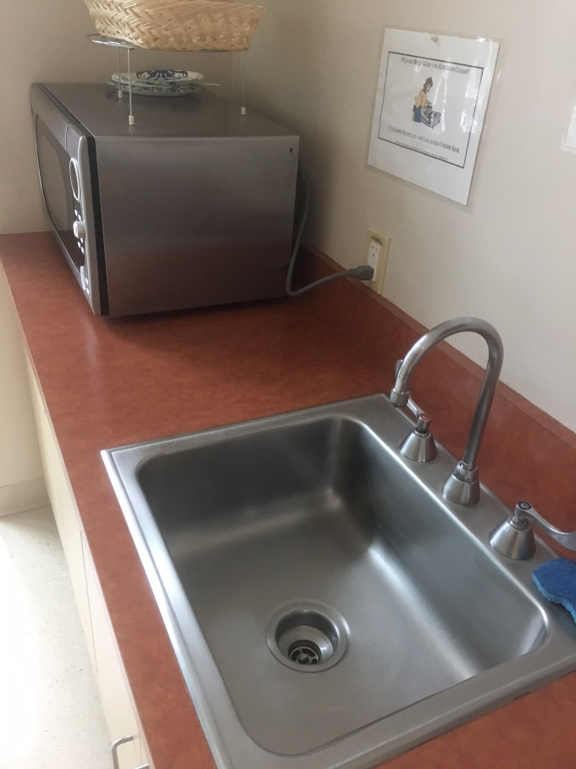
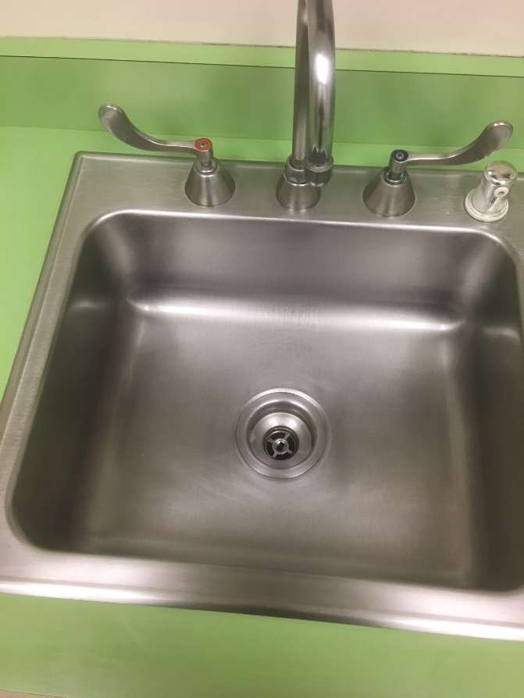
Sinks & countertops

Slide 11
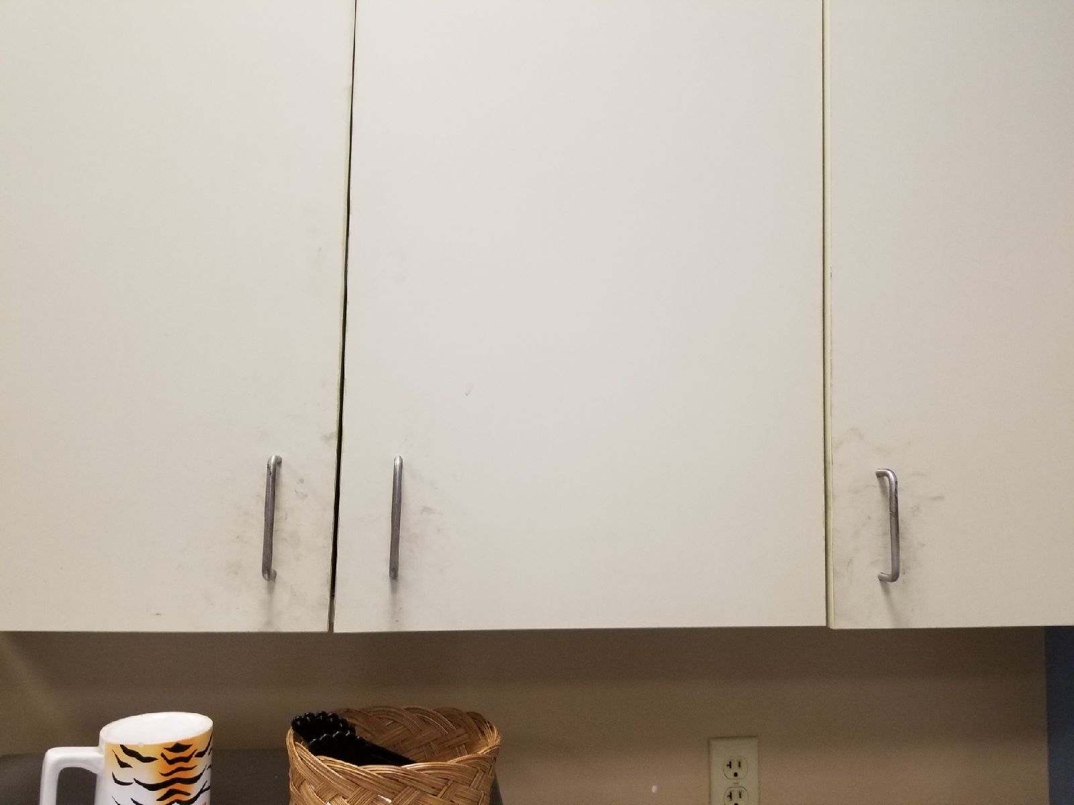
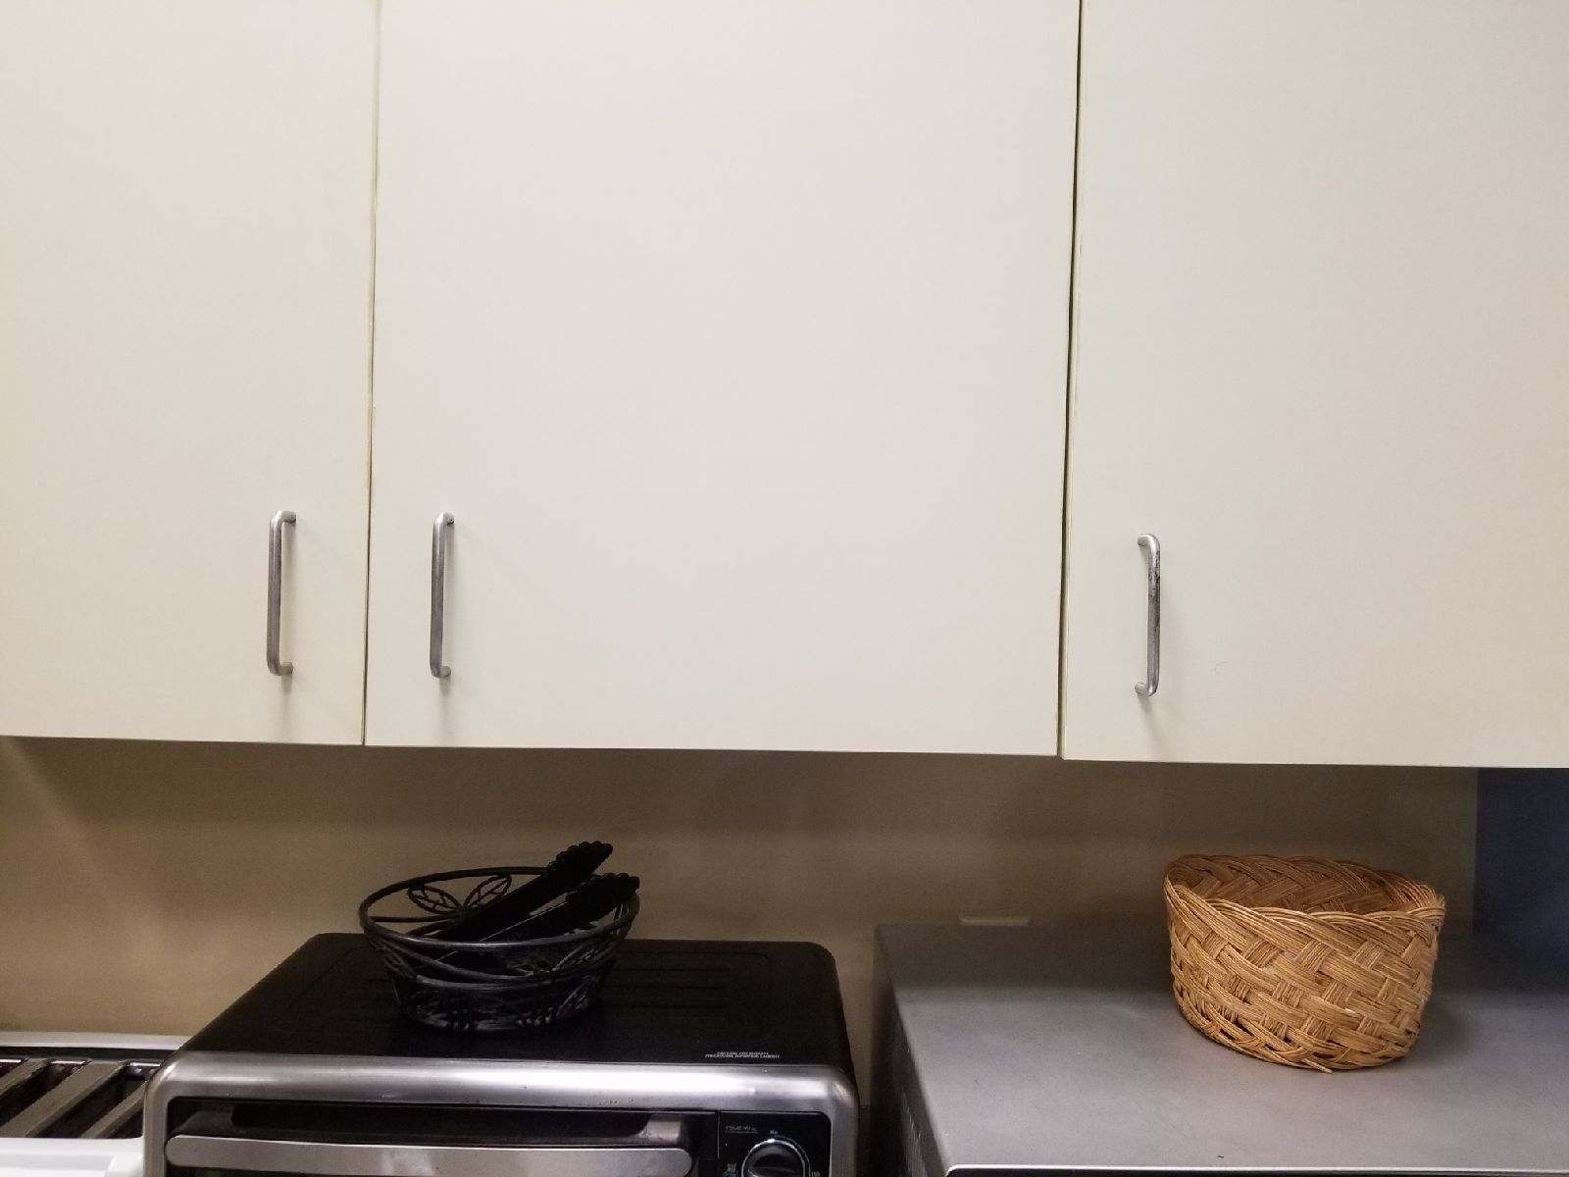
Walls & cabinets

Slide 12
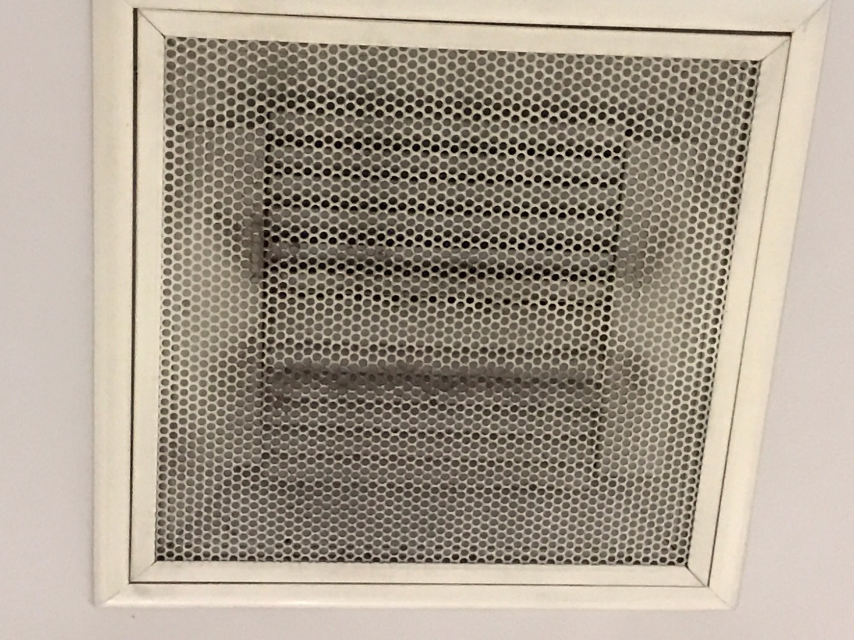
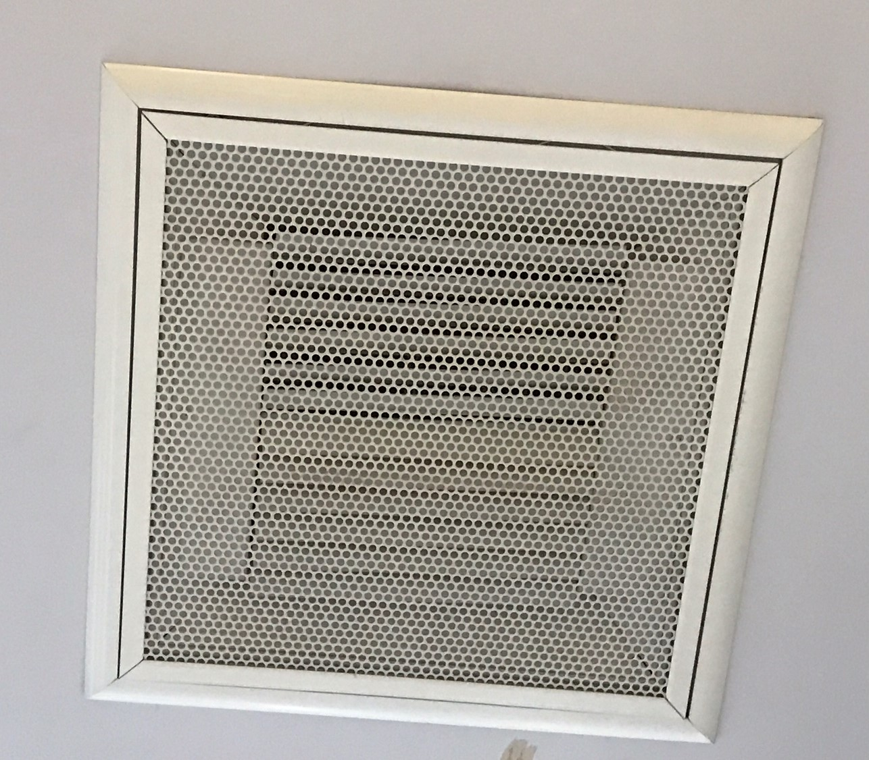
vents

Slide 13
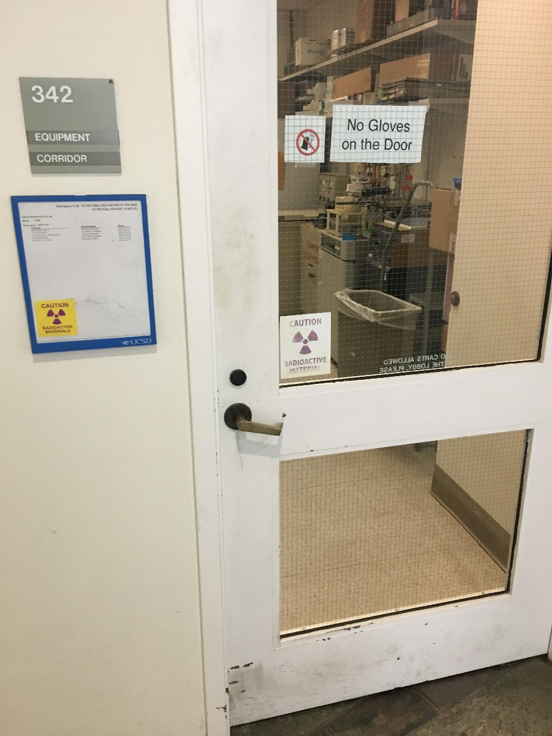
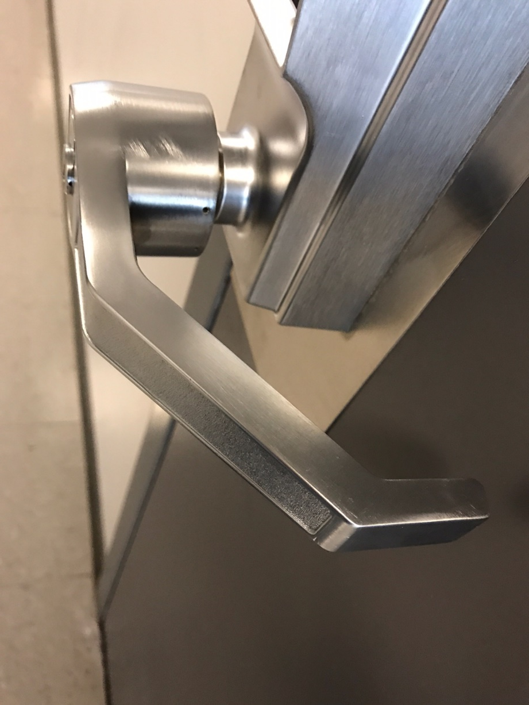
Doors, frames and handles

Slide 14
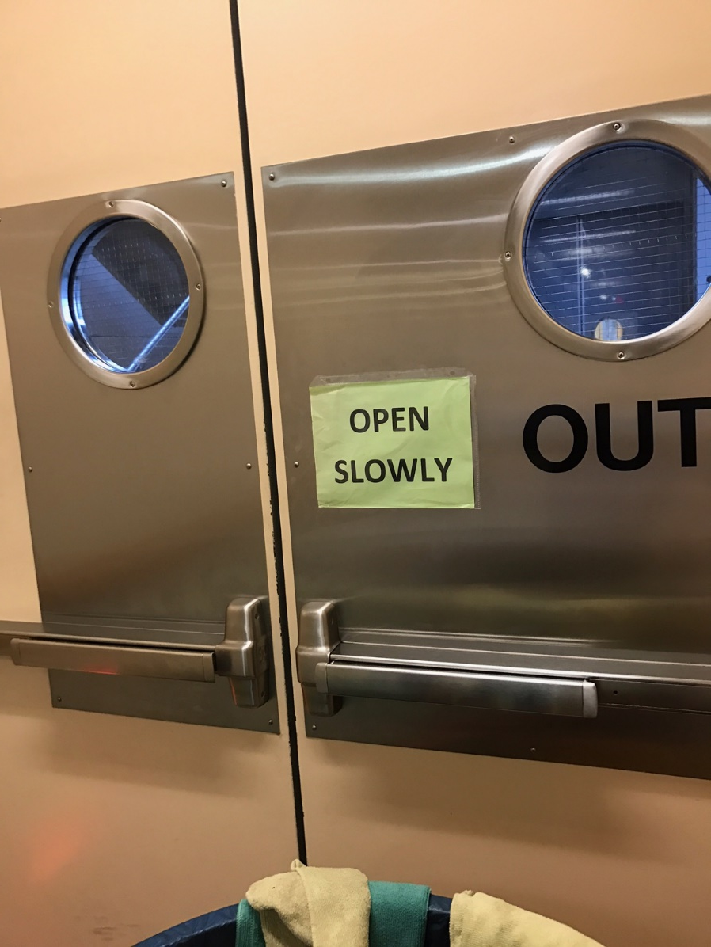
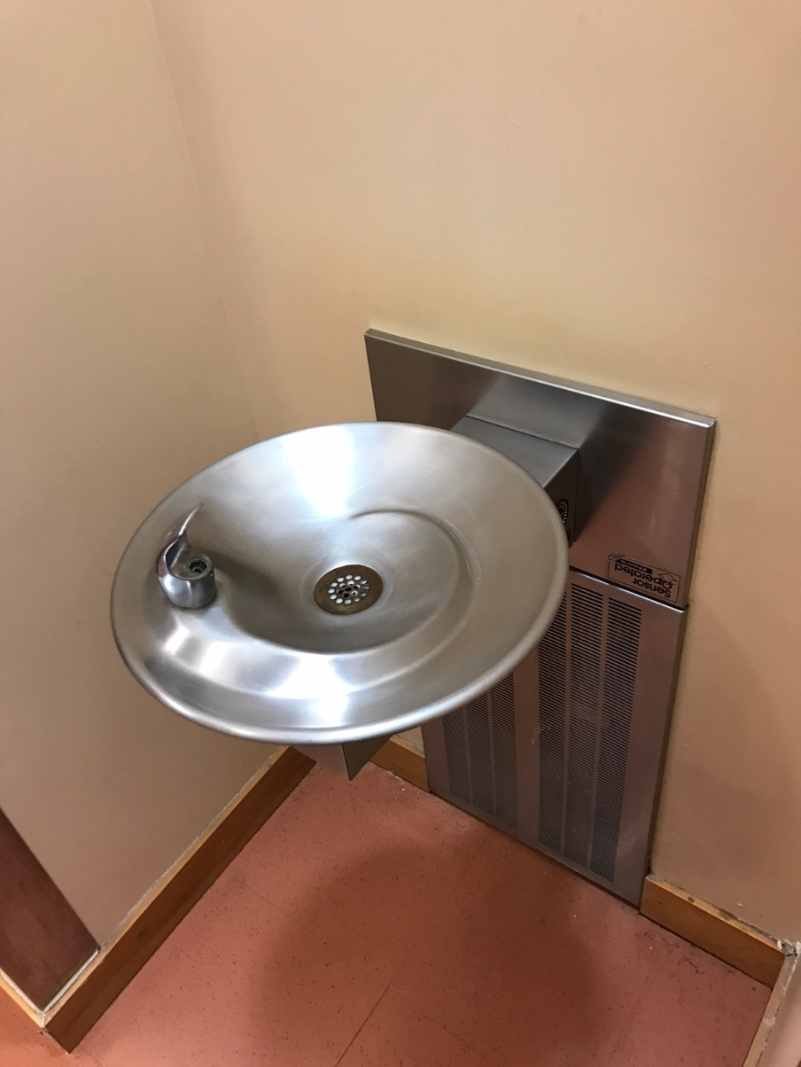
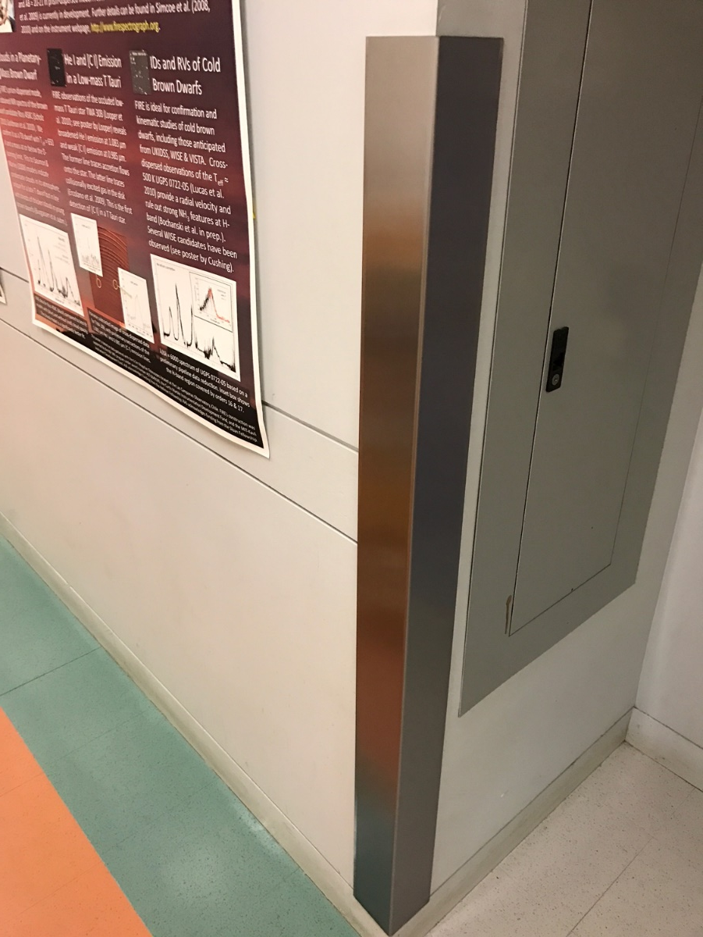
Stainless features

Slide 15
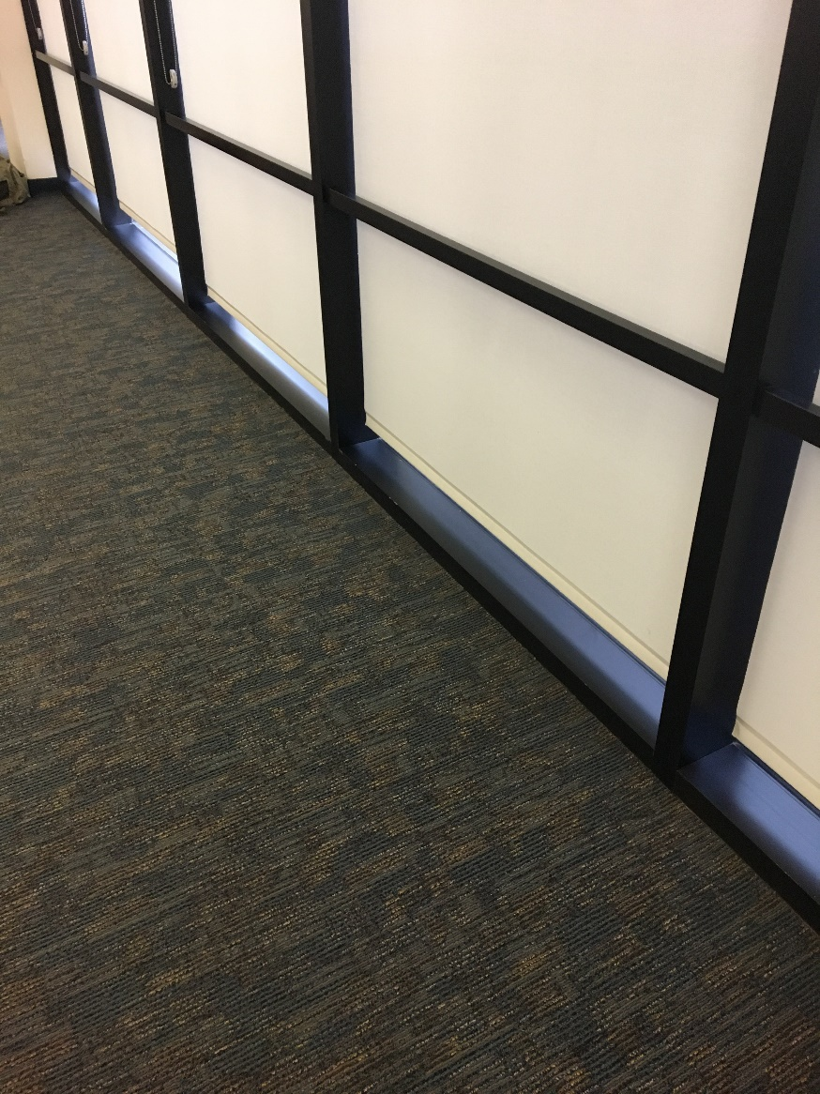
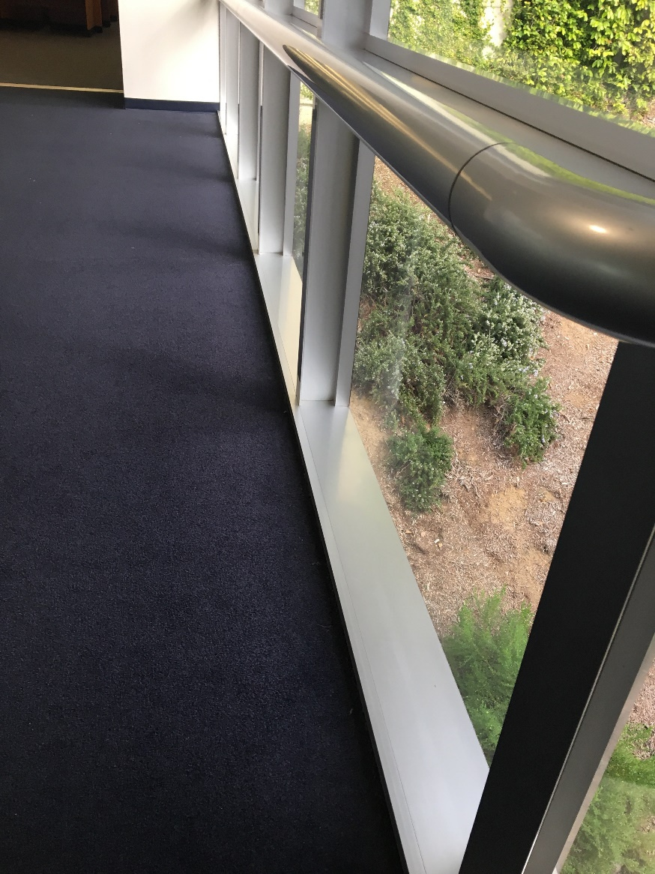
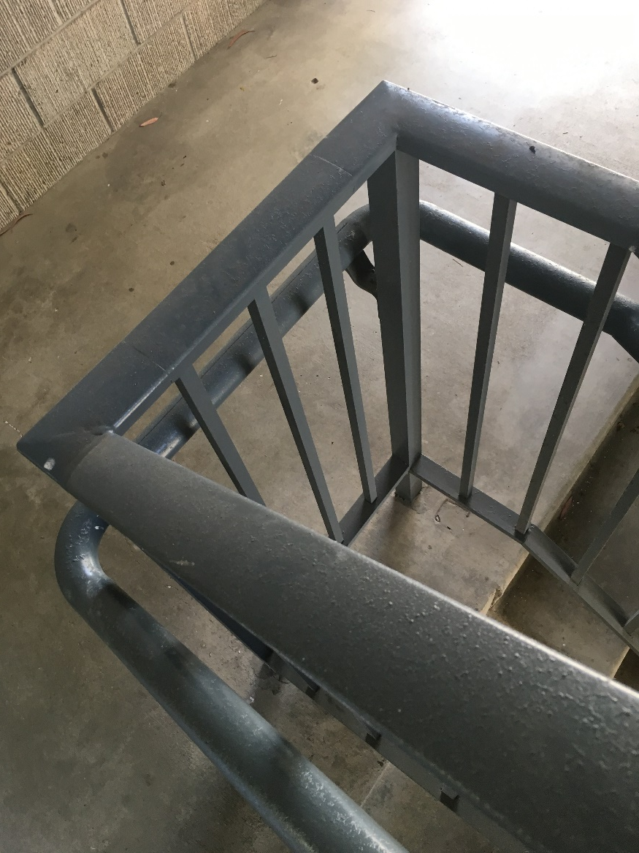
Window frames & handrails

Slide 16
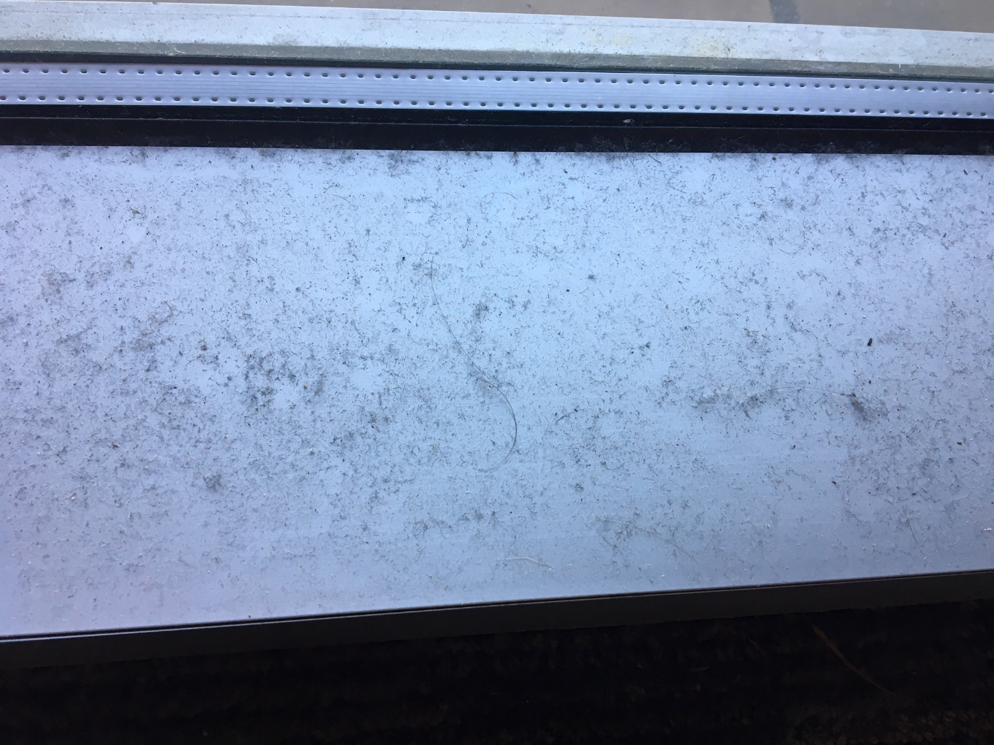
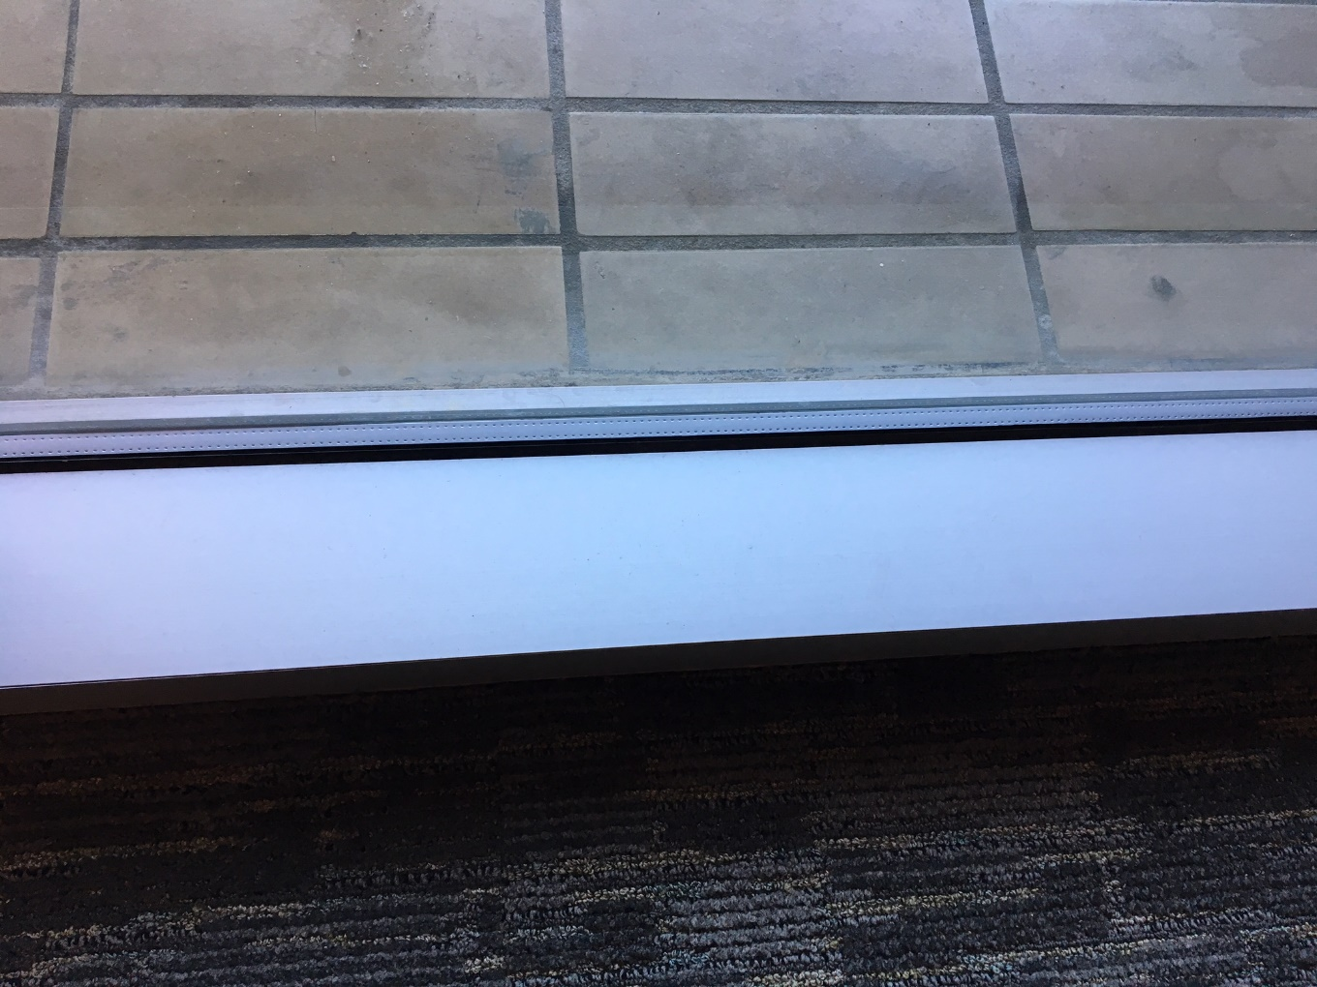
Window Sills

Slide 17

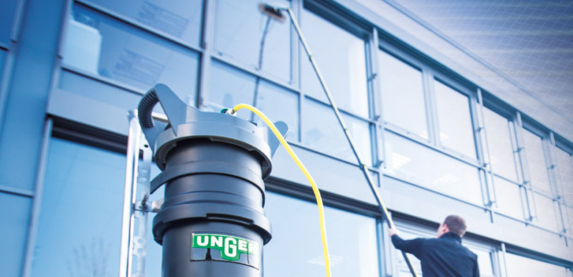
Interior & Exterior window washing

Slide 18
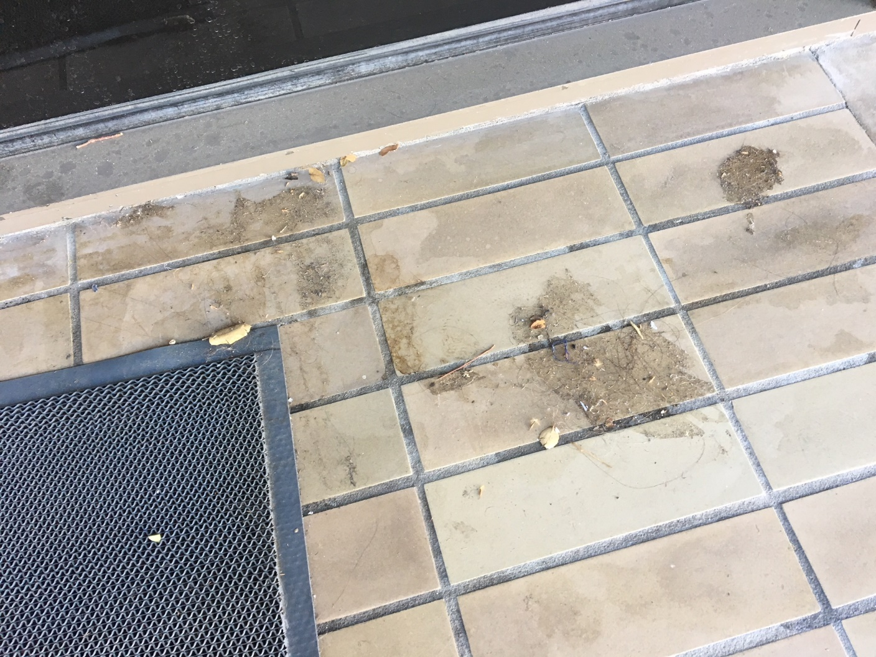
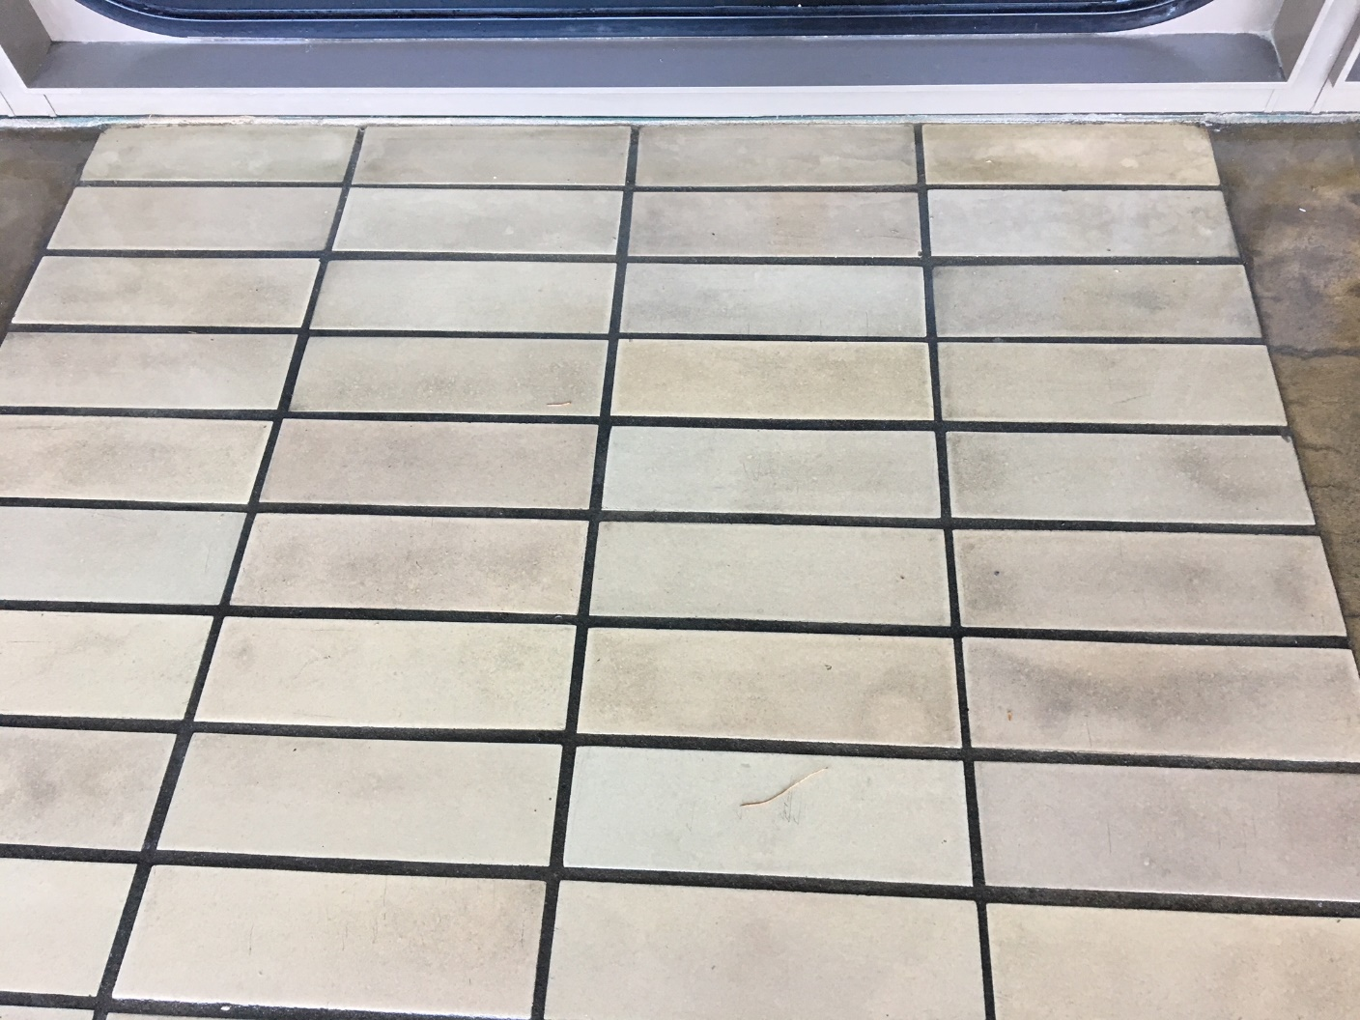
Patios under overhang

Slide 19
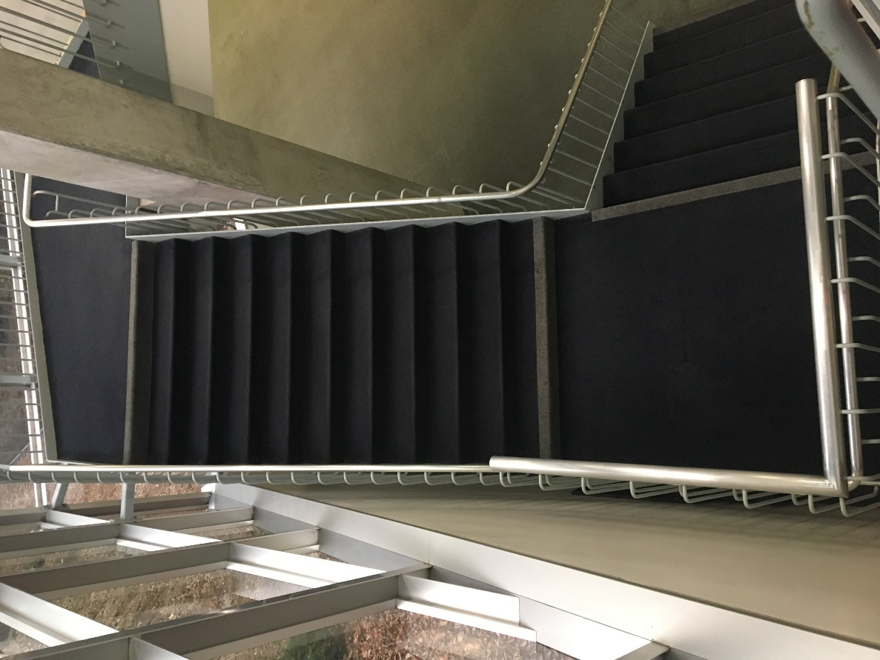
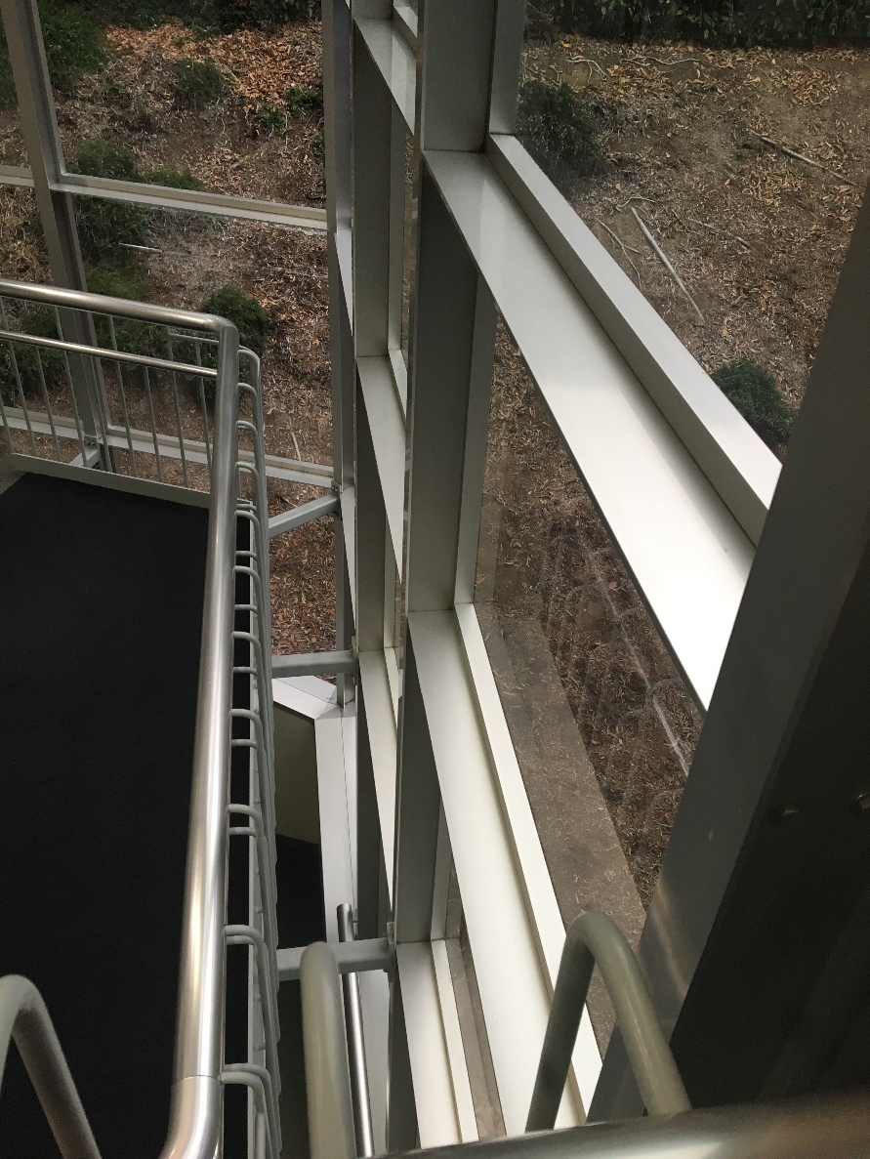
Ledges & stairwells

Slide 20
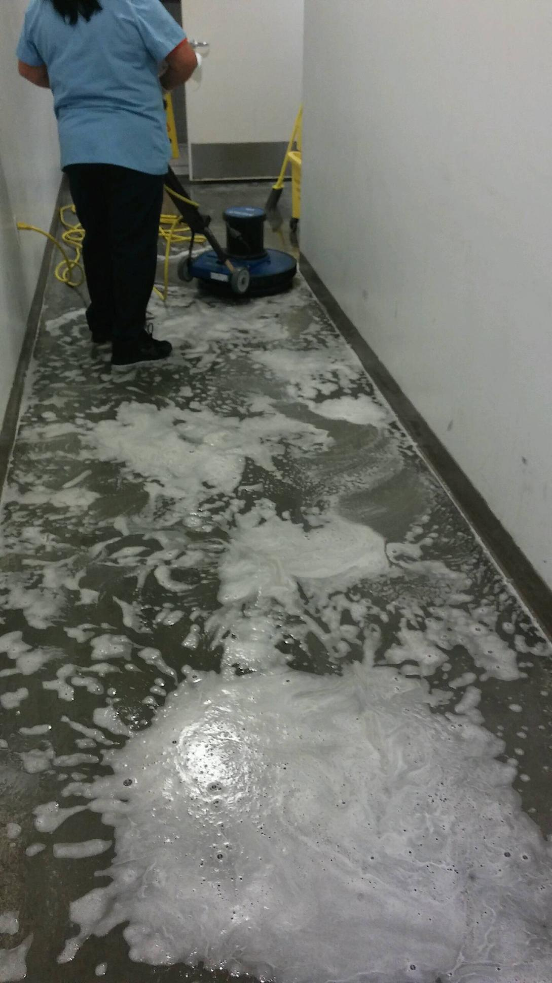
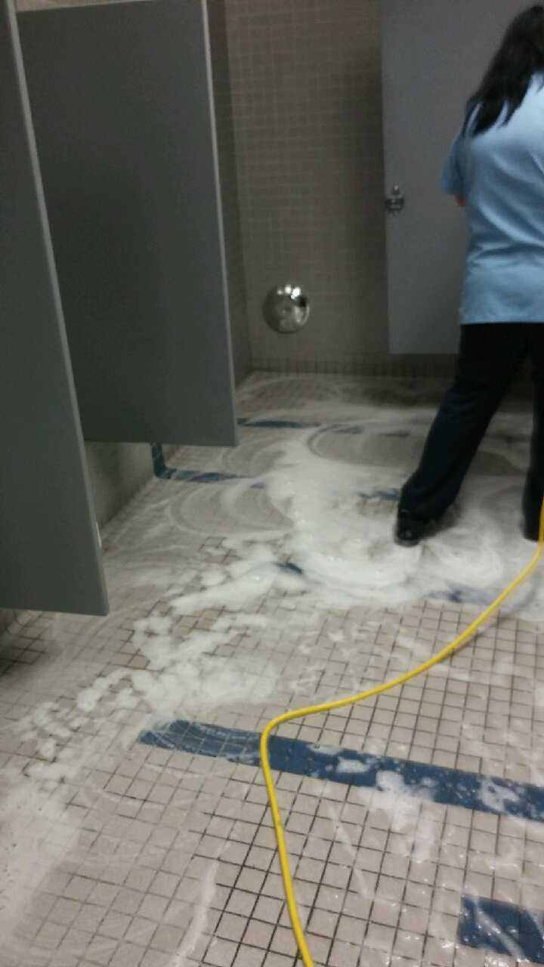
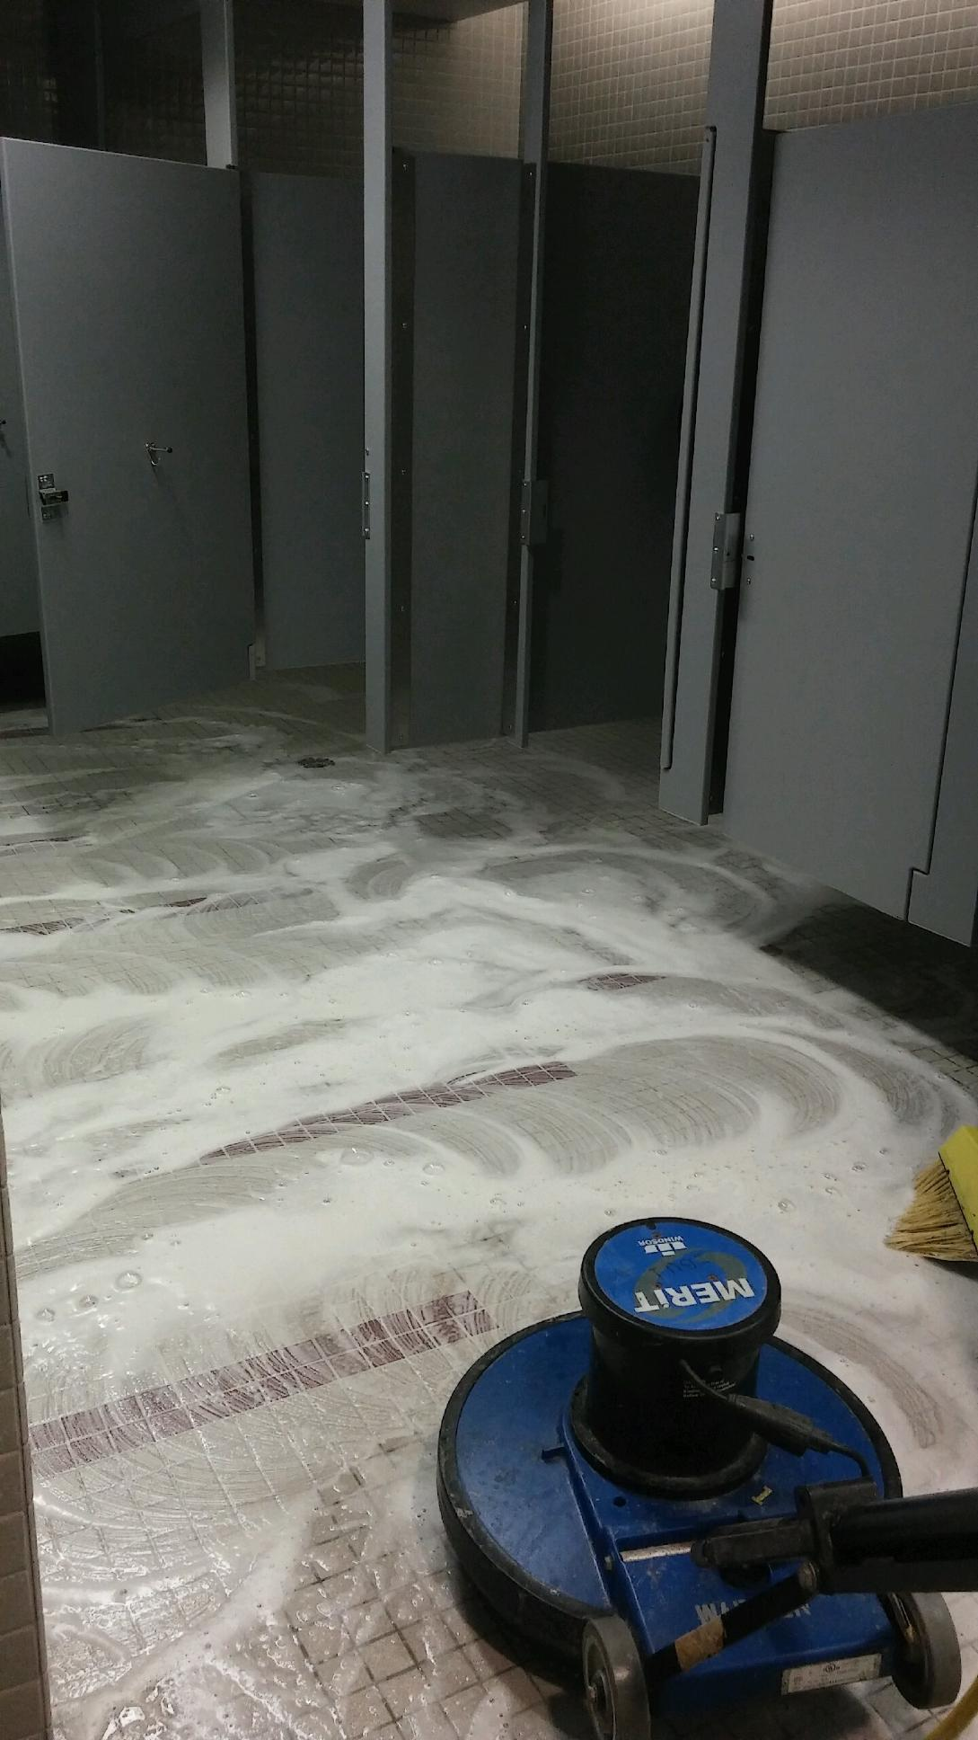
Restroom floors

Slide 21
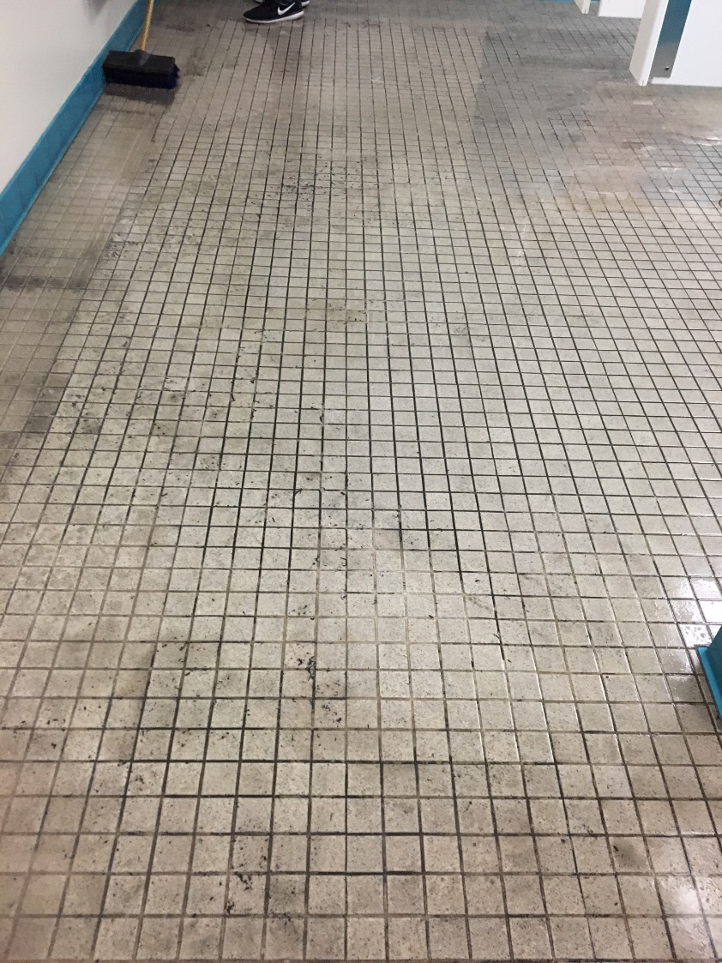
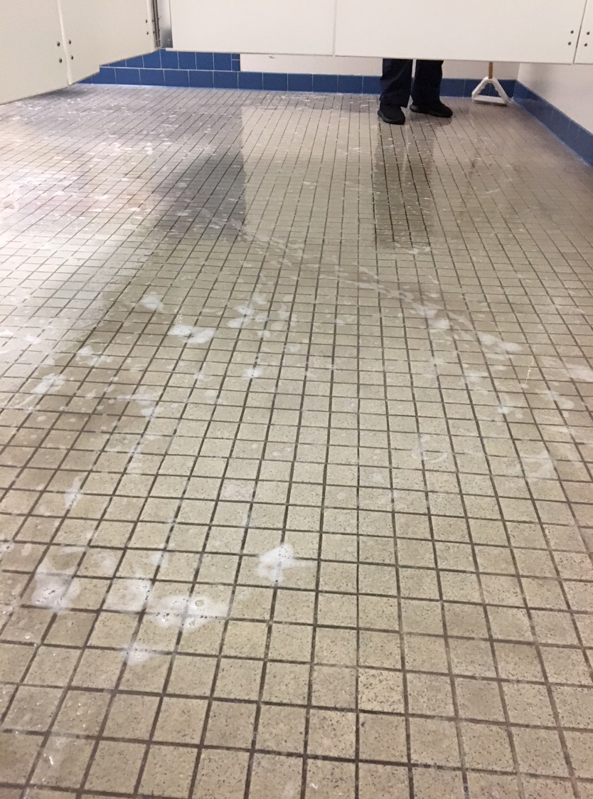
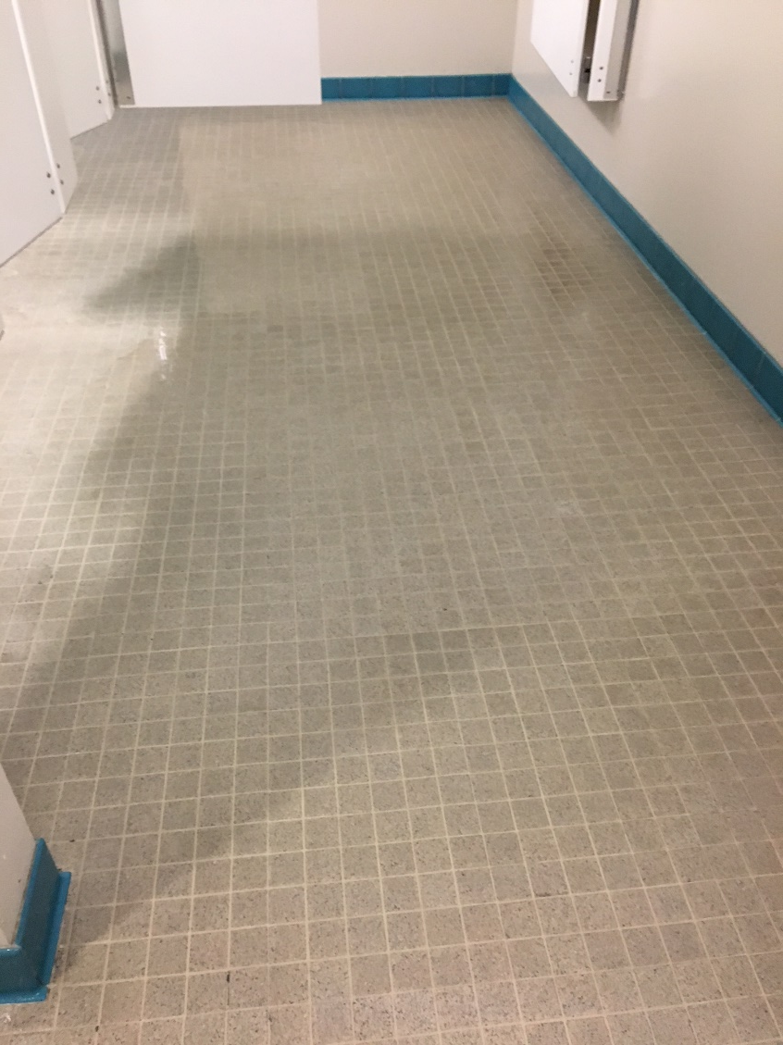
Grout cleaning

Slide 22
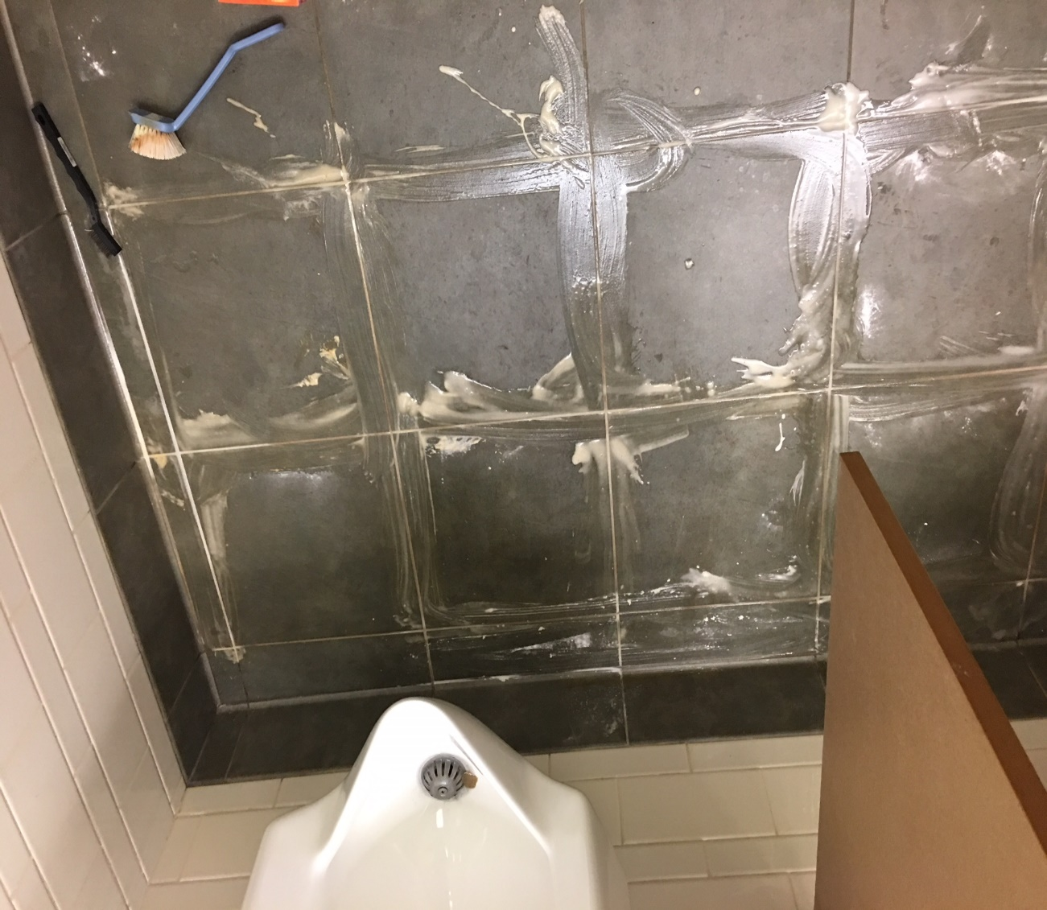
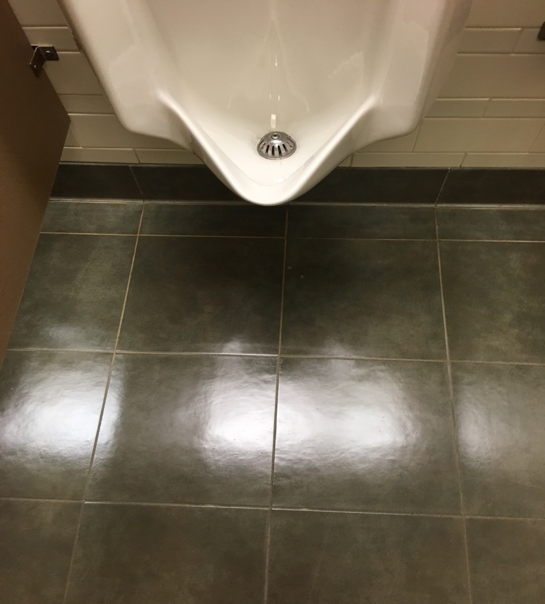
Grout cleaning & refinishing

Slide 23
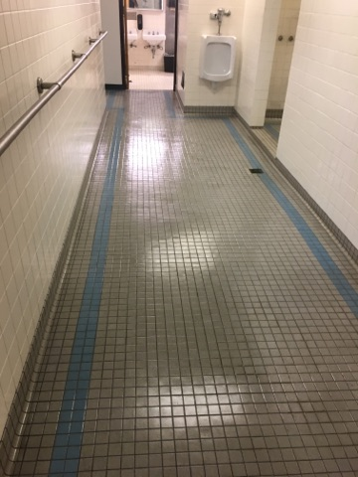
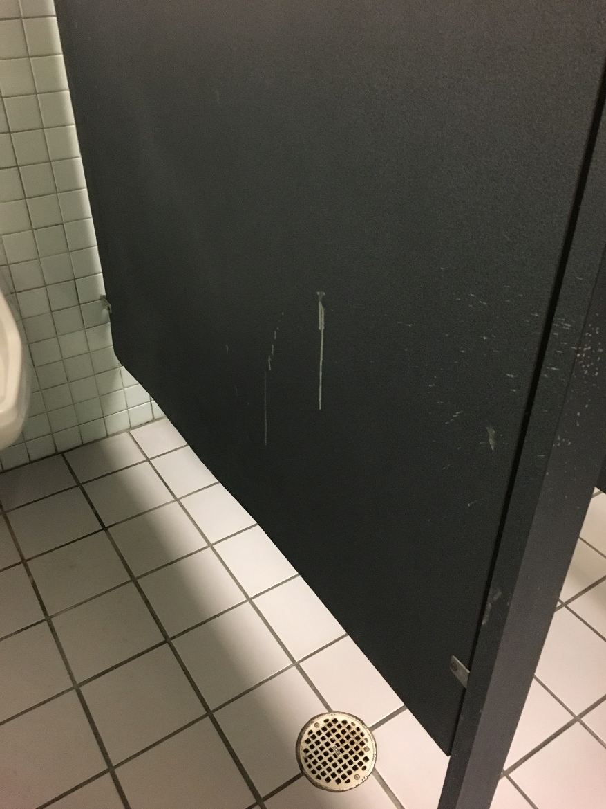
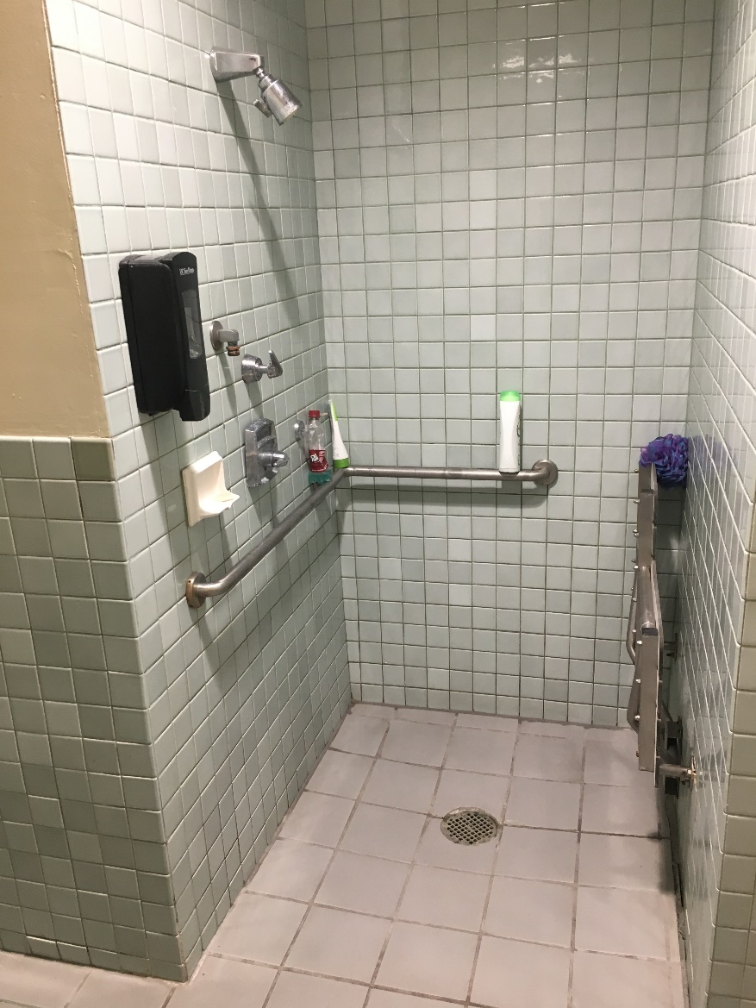
Restroom Partitions, showers & walls

Slide 24


Locker Rooms

Slide 25


Shower stainless steel fixtures

Slide 26


Upholstery cleaning (on recharge basis)

Slide 27



Classrooms – tables, desks, chairs, boards, floors

Slide 28


Classroom floor re-finishing

Slide 29


Lecture Halls

Slide 30

Classrooms Chairs

Slide 31


Conference & meeting rooms

Slide 32



Hard surface floor care

Slide 33


Floor care

Slide 34


Floor care

Slide 35


Floor care

Slide 36



Floor care

Slide 37


Making it shine again

Slide 38


Making it shine again

Slide 39


Carpet cleaning

Slide 40


EBU3A carpet before and after

Slide 41


Carpet cleaning

Slide 42


Removing carpet stains

Slide 43



Carpet care

Slide 44

Additional work can be scheduled
Jason Kayne – #858-534-1389 or jkayne@ucsd.edu
Yvonne Haywood-Cole, Daytime Superintendent – #858-534-9649 or yhaywoodcole@ucsd.edu
Greg DePeder, Night Superintendent - #858-822-5598 or gdepeder@ucsd.edu

Slide 45
any questions?

Slide 46

Summer Projects

Slide 47
Carpentry
CSC, building B double doors facing south in the conference room
Peterson 103 raise chair rail to proper height
WLH 2001 tighten and replace failing anchors , 2005 tighten and replace failing anchors
Galbraith 242 tighten and secure all tablets
York Hall 2622 tighten and replace failing anchors
SERF building, fire rated damaged doors replacement
BRF II vision lite install fire rated doors (ADA compliant)

Slide 48
Access Control
Temp Re-key Fireside Lounge in June, to be changed back in August
Cut all missing keys from dorm units after full inventory is completed (approx. 2000 keys last year) before next year’s move-in.
Complete full Knox Box inventory for all housing areas
Continued full support for Coast Apts, Mesa Apts, La Jolla Del Sol
Mandeville Auditorium ADA lock retrofit project (approx. 25 locks switched from knobs to lever sets)
Complete keying support for Canyon Vista renovation (approx. 50 doors).

Slide 49
Lighting
The relampers are going to be working on relamping and replacing burnt out ballasts at the following lecture halls:
  Center Hall
  McGill Hall
  Galbraith Hall
  York Hall
  Warren Lecture Hall
Retrofitting will happen at these locations:
  Pawka Green – 50 watt LPS to LED Total of 20 new poles and new LED fixtures
  Mayer Hall – 50 watt HPS to LED Total of 4 wall packs
  Social Sciences - 75 watt HPS to LED Total of 6 new LED

Slide 50
Fleet Services
Summer Campaign
CHP Safety Inspection

Slide 51
California Highway Patrol Inspection
What is it? An annual inspection to ensure commercial operators are in compliance with California DMV rules and regulations
Fleet Services is accountable for ensuring that the University’s transit buses are safe and pass an inspection performed by CHP inspectors
Takes place during the summer on an annual basis. Roughly 20% of the fleet is selected at random for audit

Slide 52

What are they looking at? CHP Safety Inspection List:

Slide 53

CHP Inspection (con’t)

Slide 54
Keys to a Positive Result
Preparation
Maintenance without compromise
Convey and share results with Transportation Services
Remedy any issues of concern promptly
Incorporate changes into maintenance regimen based on any areas of opportunities identified

Slide 55
How have we done?
Last 10+ years: No major violations
9 buses inspected last year
4 buses with violations
3 had “Carrier Name Required” violations (no signage)
2 had non-serious general maintenance violations (one for inoperative seat air ride along with a broken adjustment knob; one for loose gear and applied air loss)
We now inspect for air loss with higher scrutiny

Slide 56

Thank You!

Slide 57



Facilities Management
Project Management

Slide 58

FM Project Management

Slide 59

FY19/20 Summer Tree Trimming Projects and Fuel Management Program
June 25, 2019

Slide 60
Outline
FM Notification
Means & Methods
Environmental Steps Taken
Dates & Areas

Slide 61

June 25, 2019
Subject: FM Notification of Fuel Management/Brush Abatement
Start: Monday, July 8, 2019 at 7:00 am
End: Friday, August 9, 2019, at 3:00 pm (daily)
Purpose of Notification: To inform the campus community that an FM contractor will be conducting annual campus wide vegetation management/brush abatement.
How the campus community will be affected: There will be limited impact to campus operations, affected areas of campus during the vegetation management/brush abatement operations are typically areas 100ft from buildings and in the chaparral canyon areas. Traffic control will be provided as needed.
Parts of Campus to be Affected/Scope of Work: The following areas may experience elevated levels of noise for periods of time during the work. (maps attached)
Special Instructions: The affected area(s) will not be accessible, and will be cordoned off with tape or barricades. Area occupants may experience noise and odors from gas powered chainsaws, blowers, line trimmers, and chippers*.

Slide 62
Means & Methods
Gas powered chainsaws, blowers, line trimmers, machetes and chippers* will be used to trim, prune and clear areas to create defensible space between campus buildings and natural vegetation in canyons and other open space areas.
Affected areas of campus during the wildland fuel management operations are typically areas 100ft from buildings and in the chaparral canyon areas.
Affected areas will be cordoned off with tape or barricades. Signage will be placed when detours are warranted.
*Chippers will be used in the later part of the day. Plant material is chipped and reapplied to the hillside as mulch.

Slide 63
Environmental Steps Taken
Due to near record rainfall this past winter and spring FM is undertaking an early summer abatement project focused on line-trimming to remove non-native annual weeds in limited areas.
Work will be in areas that have been abated in the past based on Campus Planning and Fire Marshal review and input.
The limited list of sites that will receive this treatment was developed through coordination between FM and Campus Planning. Many environmentally sensitive areas will not receive line trimming as a means to reduce non-native annual weeds.

Slide 64
Abatement Areas

Slide 65
Che Café
July 2019

Slide 66
Deep Sea Drilling
July 2019

Slide 67
Coast Apartments
July 2019

Slide 68
Nierenberg Hall & Keck Center
July 2019

Slide 69
Seaweed Canyon
July 2019

Slide 70
La Jolla Village Drive
July 2019

Slide 71
SIO Building D
July 2019

Slide 72
Summer Tree Trimming Projects

Slide 73

Trimming along Gilman Dr. at Osler Lane and Scholars Dr.

Slide 74

Trimming along Gilman from Voigt to new bridge

Slide 75

Trimming between Faculty Club and Student Health

Slide 76
QUESTIONS ?

